Slide 1
Project Bratton
Presentation to Domtar, December 2019
Discussion Materials

Slide 2
Table of Contents
Executive Summary
Neenah Business Overview
Public Market Perspectives
Preliminary Views on Valuation
Domtar / Neenah Illustrative Combination
Potential Interloper Analysis
Appendix - Supporting Valuation Materials
Detailed Trading Comps
Neenah WACC Analysis
Proforma Income Statement

Slide 3
Executive Summary
Executive Summary
Potential Acquisition of Neenah
We recommend that Domtar Corp conduct further due diligence in consideration of a potential merger with Neenah Inc
Neenah's history, reputation, and assets make it attractive for a potential acquisition
Domtar Corp ("UFS") is considering an acquisition of Neenah Inc ("NP")
We have analyzed Domtar Corp, Neenah Inc, and a peer group that spans the paper and forestry products and paper packaging industries
Neenah has a global presence in the premium paper market
Since its founding in 1873 in Wisconsin Neenah has been known for quality
After a spin off from Kimberly-Clark in 2004 Neenah concentrated on higher margin specialty markets
Since 2006 Neenah has invested in manufacturing facilities in North America and abroad
Neenah products reach over 80 countries and manufactures in the United States, Europe, and United Kingdom
Technical Products and Fine Paper and Packaging are the segments of Neenah's diverse portfolio
Neenah must be able to meet customer preferences at a time when increasing digitalization is strong competition

Slide 4
Executive Summary
Executive Summary
Potential Acquisition of Neenah
We recommend that Domtar Corp conduct further due diligence in consideration of a potential merger with Neenah Inc
Neenah's history, reputation, and assets make it attractive for a potential acquisition
Based on a selected set of valuation methodologies, we conclude that an implied takeover price in a change-of-control transaction be $80-93
This represents a 14.5% - 33.4% premium to Neenah's current share price
Prior to pursuing a deal with Neenah, further assessment of potential synergies would be necessary
While digitalization is a strong headwind for the industry an acquisition of Neenah compliments the strategy of Domtar and offers diversity
Neenah Inc world provide Domtar Corp with an attractive set of tangible and intangible assets
Paper pulp is one of Neenah's most important raw materials
Cost synergies could result through increasing efficiencies in manufacturing and supply chain management
Neenah has an established customer base that is loyal to Neenah's wealth of institutional knowledge
Through our analysis we are confident that this transaction could create value for Domtar Corp's shareholders, while Neenah does trade higher than several peers, our valuation will validate its price and further demonstrate its value to Domtar Corp

Slide 5
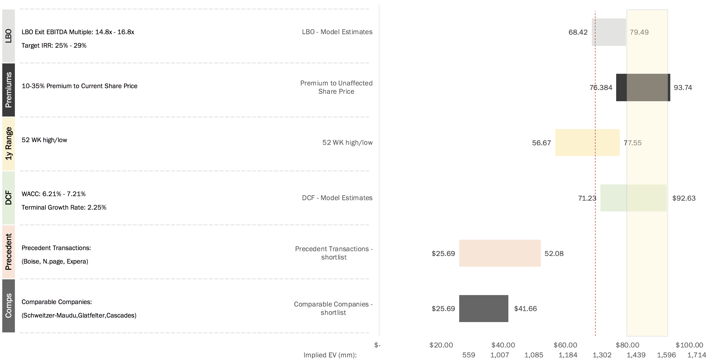
Preliminary Valuation
Subject to Further Diligence and Valuation Analysis
Shading represents preliminary valuation range.
Acquisition price: $80 - $93
Premium to current price: 14.5% - 33.4%
$69.44
80 - 93

Slide 6
Table of Contents
Executive Summary
Neenah Business Overview
Public Market Perspectives
Preliminary Views on Valuation
Domtar / Neenah Illustrative Combination
Potential Interloper Analysis
Appendix - Supporting Valuation Materials
Detailed Trading Comps
Neenah WACC Analysis
Proforma Income Statement

Slide 7
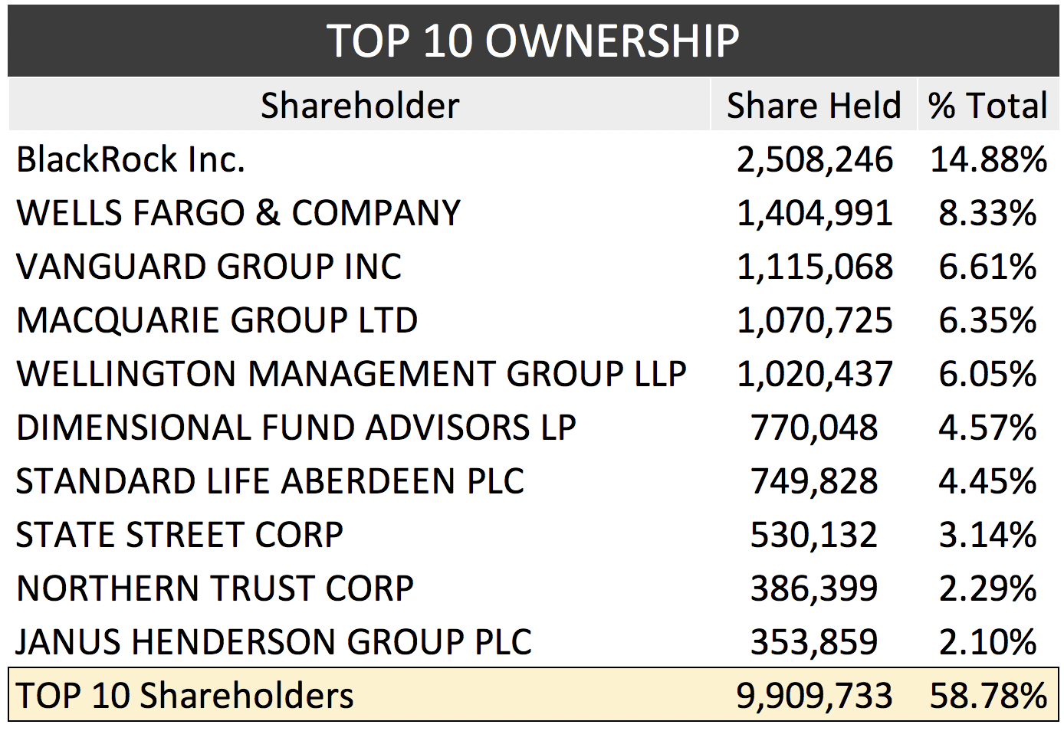
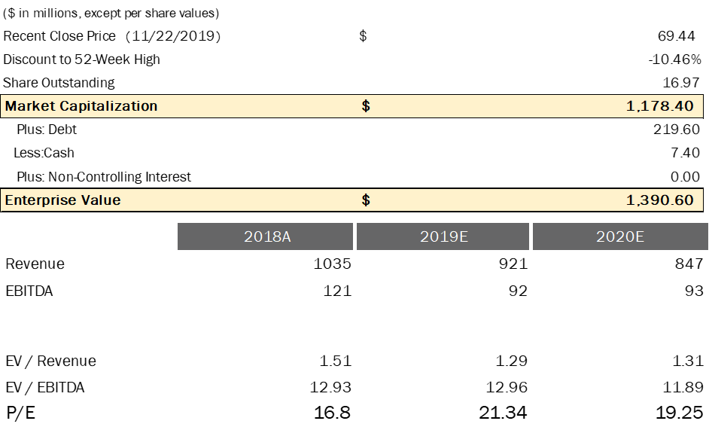
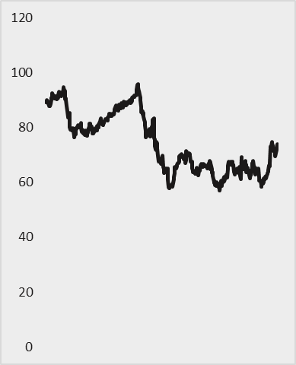
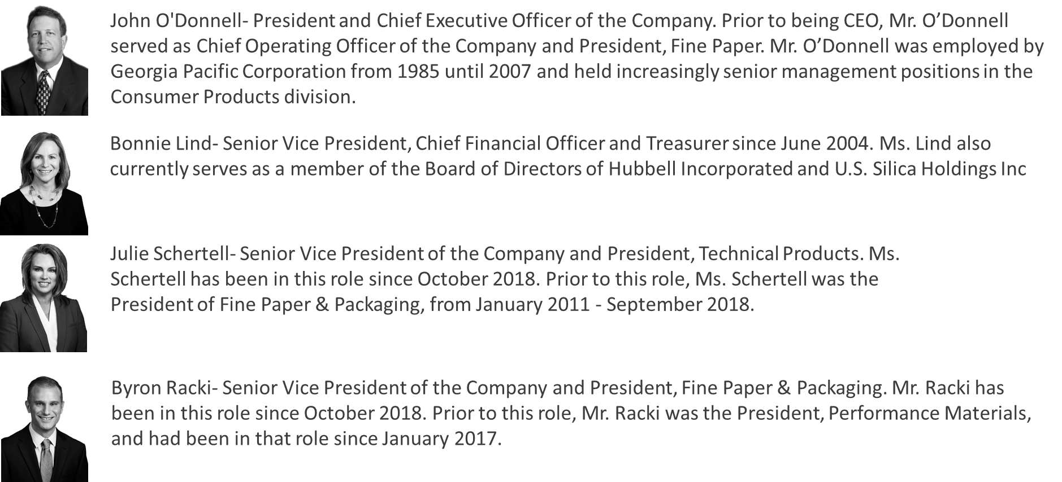
Neenah
Company Overview
Business Overview
Key Financial Metrics
Neenah is engaged in the technical products and fine paper and packaging business.
Neenah has $744.4 MM revenue in U.S., $216.5 MM in Germany, and $74 MM rest of Germany Geographically.
Company HQ located in Neenah, Wisconsin
A specialty materials company organized into 2 primary businesses; a performance based technical products business and a premium fine paper and packaging business
Two-Year Price Performance
Key Executives
Company News
11/26/19: Neenah Announces 4 Percent Dividend Increase and 2020 Share Repurchase Plan
11/13/19: Insider Trends: 90-Day Insider Selling Trend Prolonged at Neenah
10/08/19: Sidoti & Company, LLC is hosting a corporate access non- NP US Equity deal roadshow for Neenah Inc.
09/19/19: Neenah to Present at DADCO Annual Diversified Industrials & Services Conference
04/10/19: Moody's affirms Neenah's Ba2 CFR, outlook remains stable. The affirmation of Neenah's ratings reflects our expectations that the company will be able to maintain strong balance sheet credit metrics despite challenging growth expectations and raw material price inflation

Slide 8
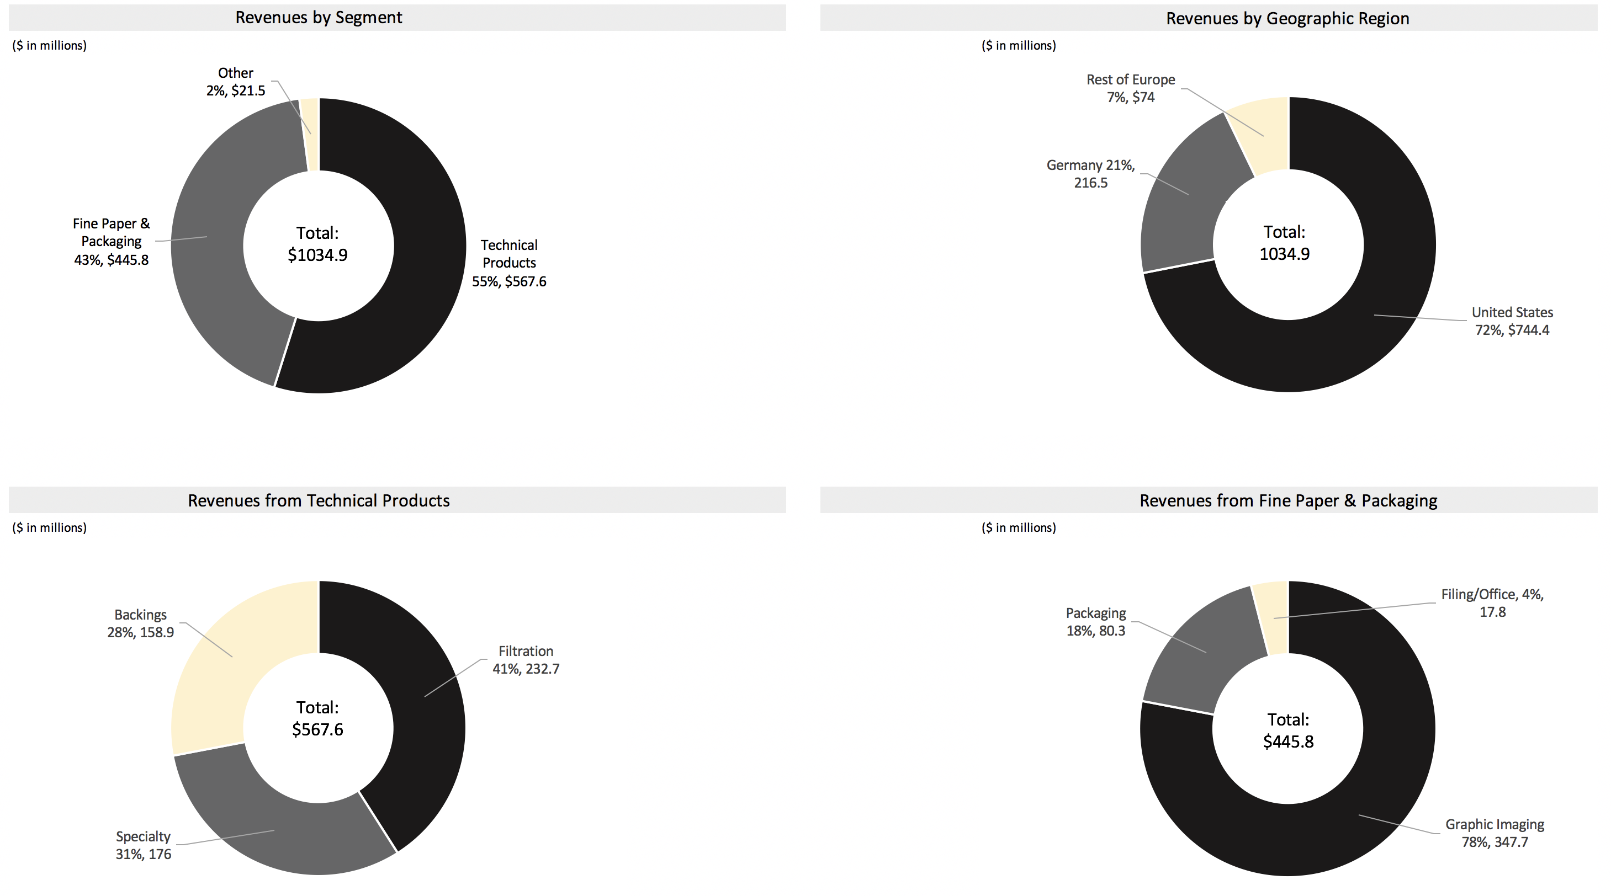
Detailed Business Overview
Company Overview
FY2018
Although the largest segment of revenues comes from Technical Products, the largest revenue producer comes from the Fine Paper & Packaging Segment
Sales are predominantly compiled in the United States, with only a little more than a quarter from Europe, mostly Germany
Technical products has a closely correlated group of revenue streams, while Fine Paper & Packaging predominantly gains revenues from Graphic Imaging
Note: Figures Based on FY2018 Earnings Source: Neenah 10-K

Slide 9
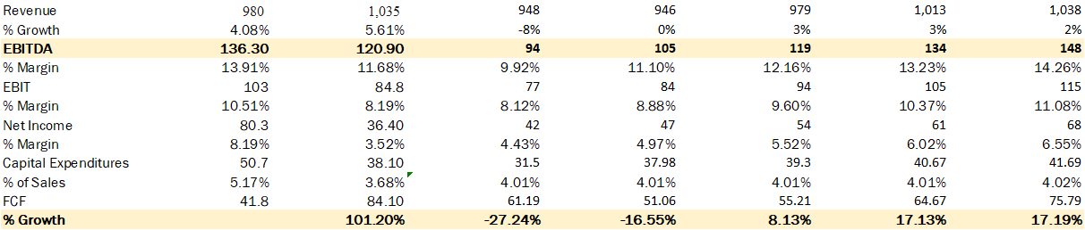
Historical and Projected Financial Performance
Summary Financials
($ in millions)
Historical
Projected
2017A
2018A
2019E
2020E
2021E
2022E
2023E
Neenah has a stable EBITDA from historical years to projected years
Neenah has an unstable FCF which has a large increase in 2018.
Key Balance Sheet Items – As of 2018
Management aims to maintain total
debt around $250 million during the project years

Slide 10

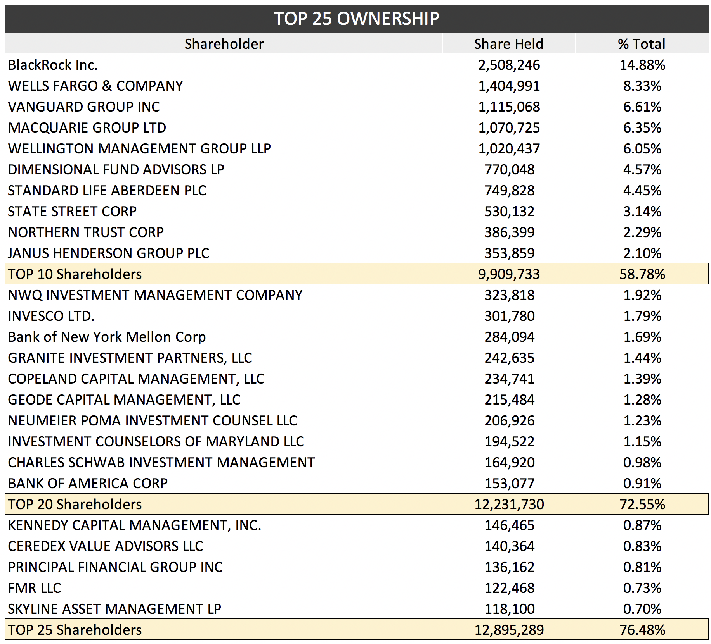
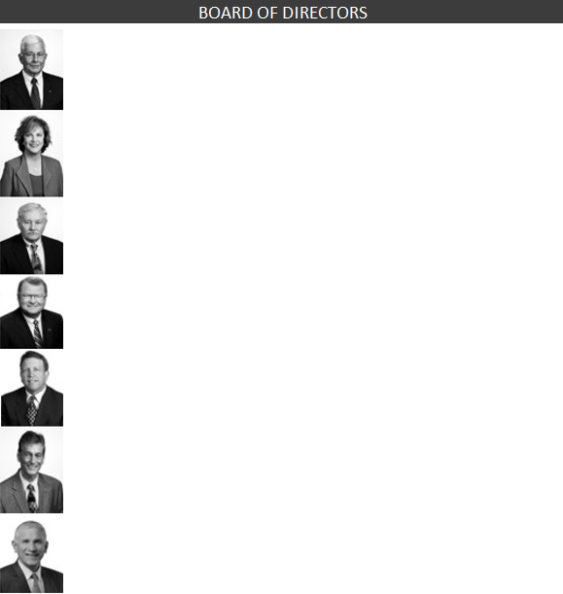
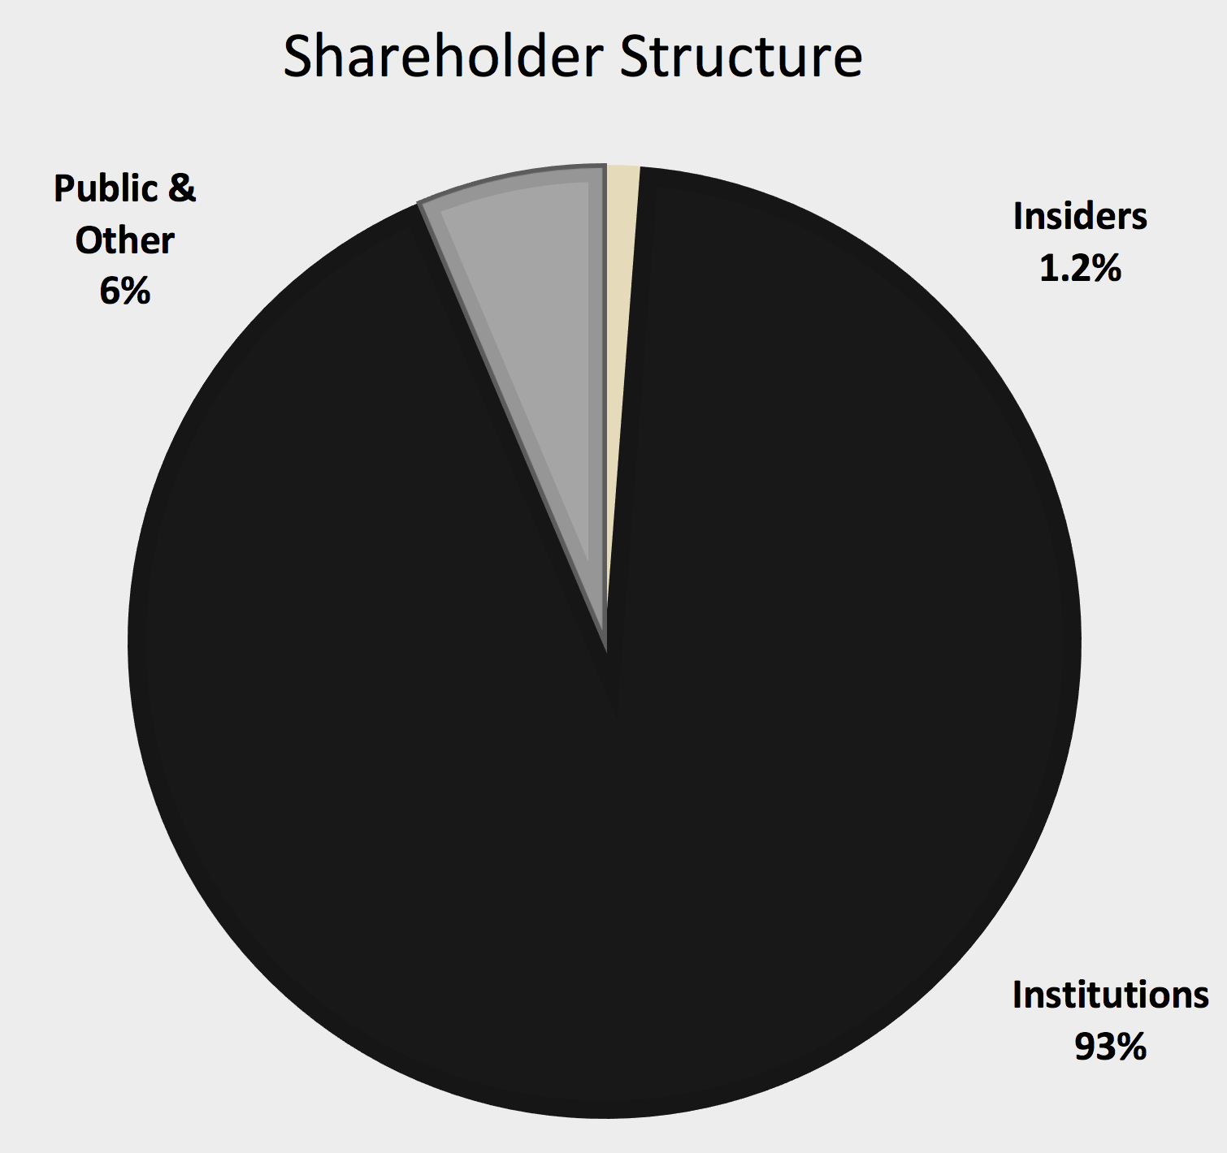
Ownership and Board Summary
Company Overview
The top 25 shareholders hold a significant amount of Neenah, Inc stock. They account for 76.48% of Neenah's outstanding shares
Neenah's Board of Directors are compiled of very diverse business leaders, whom they feel are best suited for continuous growth opportunities.
William M. Cook
Independent Chairman
(66)
Former Chairman, President, and CEO of Donaldon Company
Also serves as a Director of IDEX Corp., and Valspar Corp.
Margaret C. Dano
Independent Director
(60)
Chairman of the Board for Superior Industries International
Former Vice President of Honeywell International
Timothy S. Lucas
Independent Director
(73)
Served as an independent consultant on financial reporting issues practicing as Lucas Financial Reporting since 2002
Former FASB Director of Research and Technical Activities
Philip C. Moore
Independent Director
(66)
Retired Senior Vice President, Deputy General Counsel and Corporate Secretary, TD Bank Group
Former Partner at Canada's National Law Firm, McCarthy Tetrault LLP
President and and CEO of Neenah, Inc.
Previously served as COO and President, Fine Paper for Neenah, Inc.
John P. O'Donnell
CEO, President, and Director
(59)
Stephen M. Wood
Independent Director
(73)
Operating partner with Snow Phipps Group LLC, an international diversified investment company
Former President, CEO, and Chairman of FiberVisions Corp.
Tony R. Thene
Independent Director
(58)
President, CEO, and Board Director of Carpenter Technology Corporation
Previously served as CFO for Carpenter Technology Corporation

Slide 11
Table of Contents
Executive Summary
Neenah Business Overview
Public Market Perspectives
Preliminary Views on Valuation
Domtar / Neenah Illustrative Combination
Potential Interloper Analysis
Appendix - Supporting Valuation Materials
Detailed Trading Comps
Neenah WACC Analysis
Proforma Income Statement

Slide 12
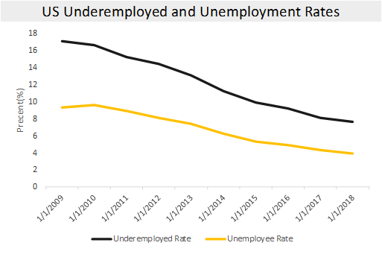
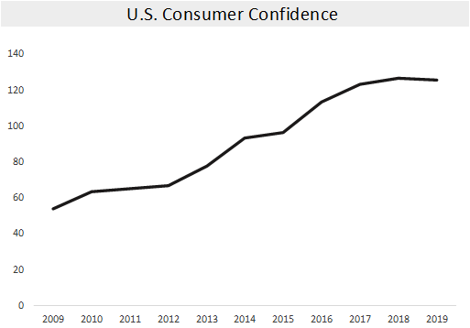
Industry Dynamics
Public Market Perspectives
Macro Indicators
The US economy has increased a remarkable recovery since the financial crisis
Falling unemployment and rising consumer confidence suggest the US is returning to strength and stable economy. For producers such as Domtar and Neenah this is a good news
On the other hand, Trade war still can reduce the speed of US economic recovery. People did not see the end of this trade war in the recent Year
Risks on the Horizon?
Foreign exchange risks from a strong dollar can create additional negative headwinds for US exporters
Trade war with China still hurt US economy a lot. The government does not want to end this war with china in the recent year.
The global economy keep at the low rate to develop which will increase the time of recovering US economy.

Slide 13
Industry Dynamics
Public Market Perspectives
Key industry trends
Although the market for graphic papers is shrinking, the market for paper packaging is growing worldwide, which will be a strong revenue driver to increase the revenue in the following years
Global coated paper market size is forecast to be worth more than USD 57 billion at 2024
Asia Pacific is likely to be the most rapidly growing region with over 6% growth rate.
Neenah produce various paper and products to catch our revenue in the paper industry, which can make Neenah become more profit able.
Online Shopping
Coated Paper Market
In 2015, worldwide demand for graphic paper declined for the first time ever
Exciting new opportunities in specialized paper, sustainable packaging, and digitalization offer new avenues for growth for the paper industry
This growth is being driven by societal changes, including our changing shopping habits.
Online shopping means there is a growing need for paper and carboard packaging materials.
In order to Improve product safety, paper manufacturers will design newe packaging solutions
Global coated paper market size is forecast to be worth more than USD 57 billion by the end of 2024
the coated paper market is led by the packaging industry which accounted for over 48% of the overall share in 2015
Printing industry will lose its share owing to the increasing digitalization and popularization of e-books and online magazines and newspapers
Europe coated paper market size will remain mature in terms of growth opportunities, recording a revenue over USD 14 million in 2015. Asia Pacific is likely to be the most rapidly growing region with CAGR over 6% from 2016 to 2024
Neenah Business Trend
Neenah wants to keep the U.S. as its primary market to produce and sell its products since Neenah bought lots of manufacturing facilities in the U.S and England which will This acquisition added specialty coating and finishing capabilities, notably in premium packaging and technical products on August ,2015 Sold the factory which produce specialty papers in German on October 2015
Neenah spent 80 million USD to gain the market share in transportation filtration that increased sales 2017
Further investment will increase Neenah's size, growth rate, and portfolio diversification, which will increase market penetration and customer base. Neenah has invested in high growth specialty markets such as filtration, digital image transfer, and premium packaging
Neenah prioritizes customer satisfaction and retention
Notes:
https://www.marketwatch.com/press-release/coated-paper-market-2019-drivers-challenges-key-regions-and-forecast-by-2024-2019-05-01
https://ir.neenah.com/investors/company-overview/about-neenah/default.aspx

Slide 14
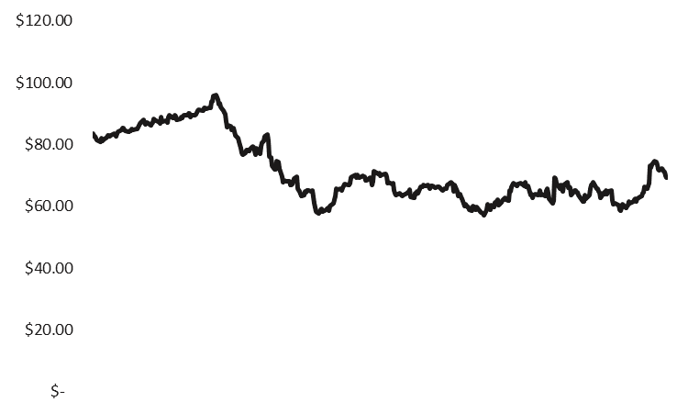
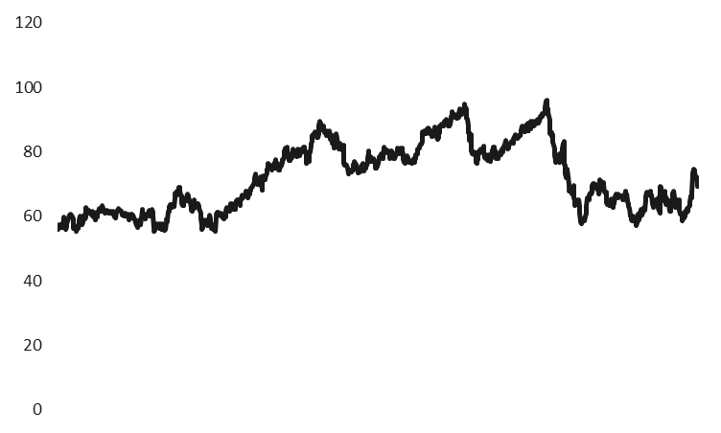
Absolute Share Price Performance
Public Market Perspectives
18 Month Share Price Performance
Neenah’s share price
has seen a gradual decline through the end of 2018, the price is stable around $60-75.
8/28/18: Insiders sells 8000 shares with a values of $714,480
Implied premium: ~38%
Share Price Statistics
Implied premium: ~12%
Price
% Premium /Discount
8/23/18: Insiders sells 2000 shares with a values of $17800
11/13/18: board members sells 6000 shares with a values of $448,787
Five-Year Price Performance

Slide 15
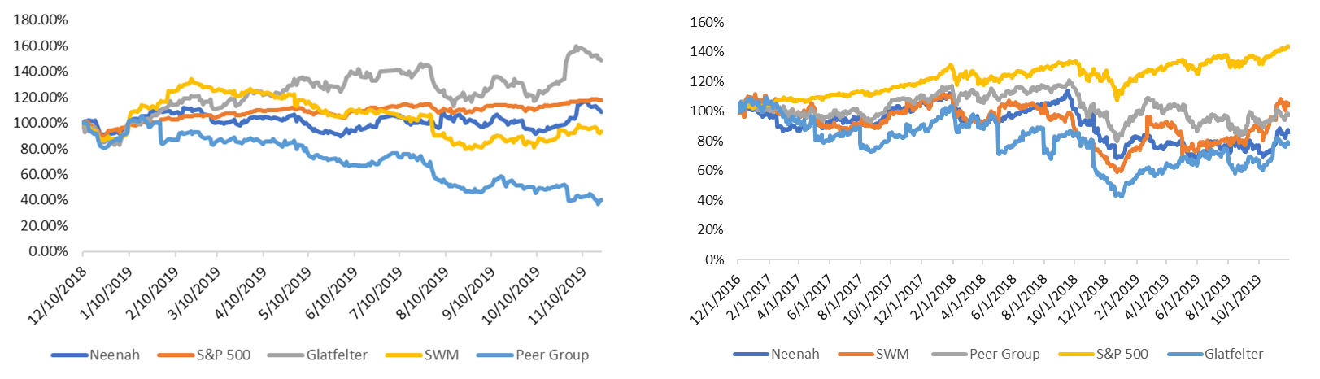
Relative Share Price Performance
Neenah has traded in line with its competitor (SWM).
Glatfelter has had solid price performance in 2019
S&P 500 has had the highest 3-YR return
One Year Relative Price Performance
Three Year Relative Price Performance
48.85%
43%
17.92%
(-2%)
4%
8.93%
(14%)
(6.20%)
-22%
(59.85%)

Slide 16
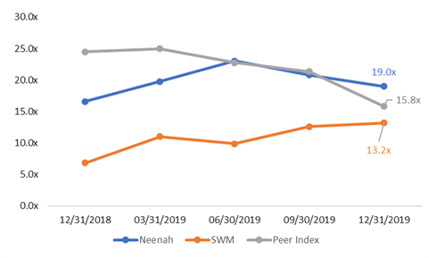
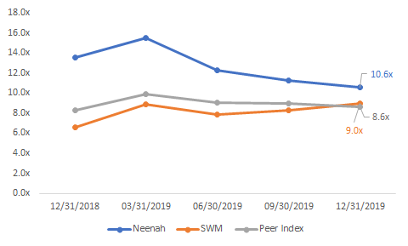
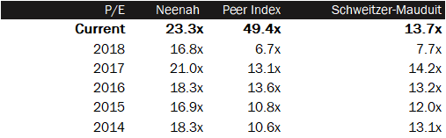
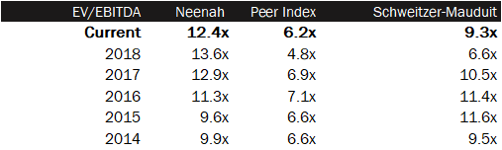
Historic Forward Looking Valuation Multiples
Public Market Perspectives
Neenah has historically
traded at higher forward
multiples than its peers in the first couple quarters prior to equaling.
Rolling One-Year Forward P/E Multiples
Rolling One-Year Forward EV / EBITDA Multiples
Multiples Statistics

Slide 17
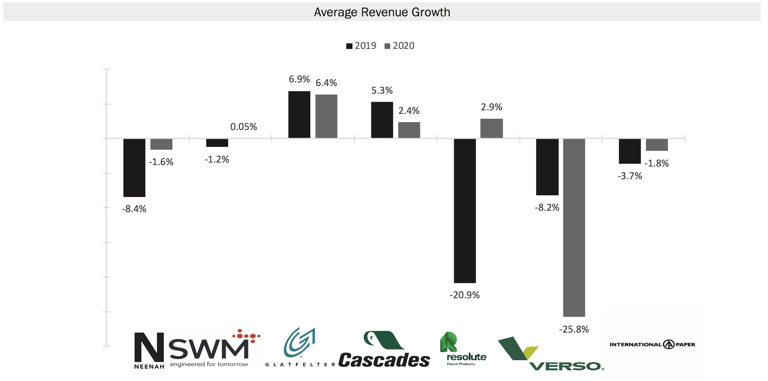
Comparable Companies Analysis
Public Market Perspectives
Trading Metrics
Operating Metrics
Neenah and its peer group can expect a decrease or slowed growth in 2020 revenue and margin.
EV/EBITDA and P/E multiples can be expected to decrease

Slide 18
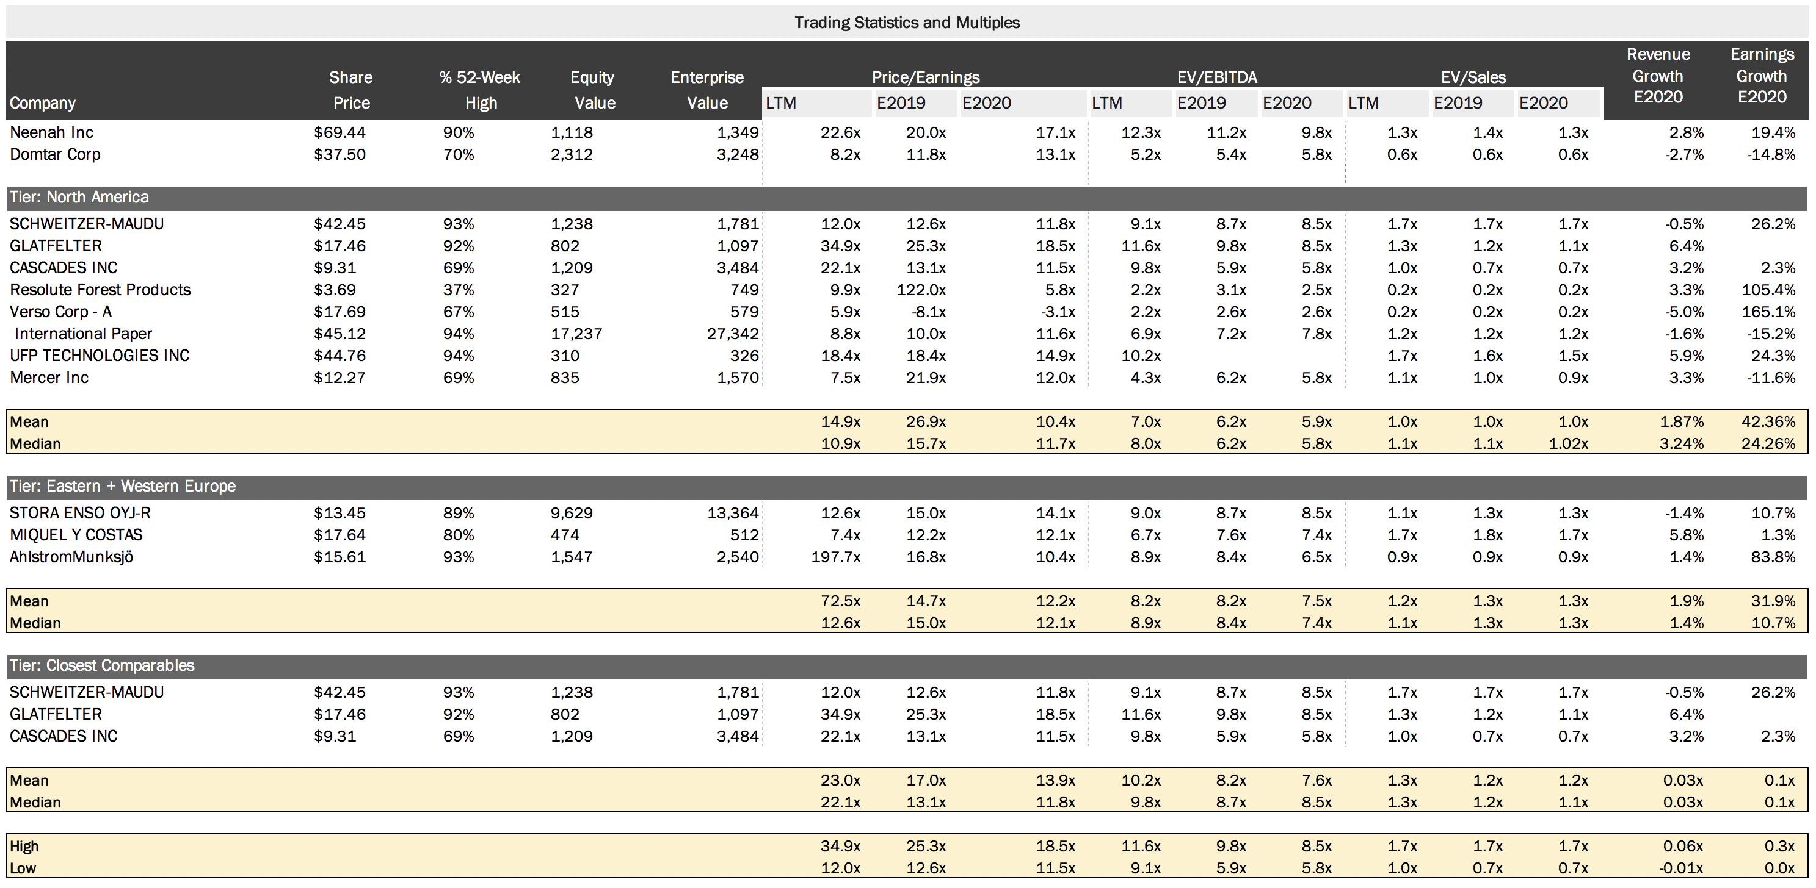
Comparable Companies Analysis
Public Market Perspectives
Neenah trades above North American and European peers on the basis of EV/EBITDA and P/E
Neenah trades close to its most refined peer group on the basis of EV/EBITDA and P/E

Slide 19
Table of Contents
Executive Summary
Neenah Business Overview
Public Market Perspectives
Preliminary Views on Valuation
Domtar / Neenah Illustrative Combination
Potential Interloper Analysis
Appendix - Supporting Valuation Materials
Detailed Trading Comps
Neenah WACC Analysis
Proforma Income Statement

Slide 20
Valuation Approach and Methodologies
Preliminary Views on Valuation
Estimate the value of an investment based on its future cash flows
LBO analysis seeks to determine the price which could be paid by a financial buyer for a target.
CCA is a process used to evaluate the value of a company using the metrics of other businesses of similar size in the same industry.
CPT is a method in which the price paid for similar companies in the past is considered an indicator of a company’s value and creates an estimate of what a share of stock would be worth in the case of an acquisition.
Discounted Cash Flow Analysis (DCF Model)
Discount future cash flows by the weighted average cost of capital to arrive at an implied enterprise and equity value
Use the perpetual growth method to arrive at the terminal value at the end of the projection period
Leveraged Buyout Analysis (LBO Model)
Determine the internal rate of return on a buyout of the company with financing in the current debt markets, sensitizing price for a variety of premia
Comparable Companies Analysis(CCA Model)
Operates under the assumption that similar companies will have similar valuation multiples with Neenah, such as EV/EBITDA
Compile a list of available statistics for the companies being reviewed and calculate the valuation multiples in order to compare them
Comparable Precedent Transactions(CPT)
Uses the same Neenah multiples as CCA. In particular, EV/Sales, EV/EBITDA and E/EPS are the most used metrics
Focus on the value of Neenah as of the time an acquisition of the business can be completed, rather than the current value

Slide 21
Neenah Projected Performance
Preliminary Views on Valuation
Neenah Projections
Revenue growth is projected to have a decrease in 2020, then stay constant in the following years
EBITDA Margins are forecast to expand slightly

Slide 22
Preliminary Valuation
Valuation Considerations
Subject to Further Diligence and Valuation Analysis
Shading represents preliminary valuation range.
Acquisition price: $80 - $93
Premium to current price: 14.5% - 33.4%
$69.44
80 - 93

Slide 23
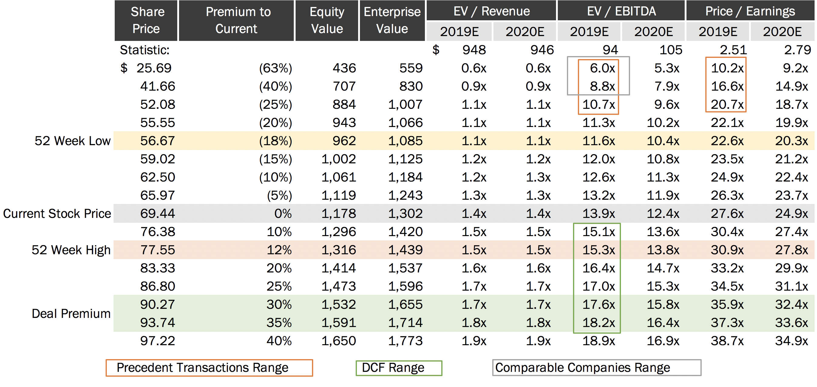
Analysis at Various Prices
Preliminary Views on Valuation

Slide 24
Comparable Companies Analysis
Preliminary Views on Valuation
Neenah trades above North American and European peers on EV/EBITDA and P/E
Neenah trades close to its most refined peer group on EV/EBITDA and P/E

Slide 25
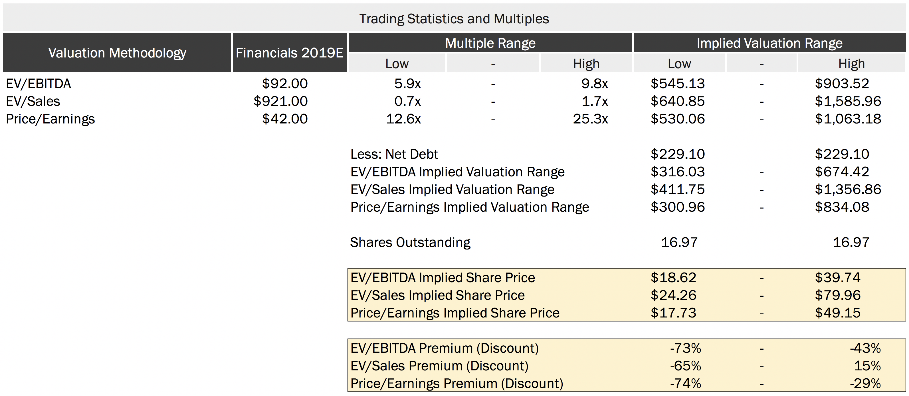
Comparable Companies Analysis (Cont.)
Preliminary Views on Valuation
Neenah trades above North American and European peers on the basis of EV/EBITDA and P/E
Neenah trades close to its most refined peer group on the basis of EV/EBITDA and P/E

Slide 26
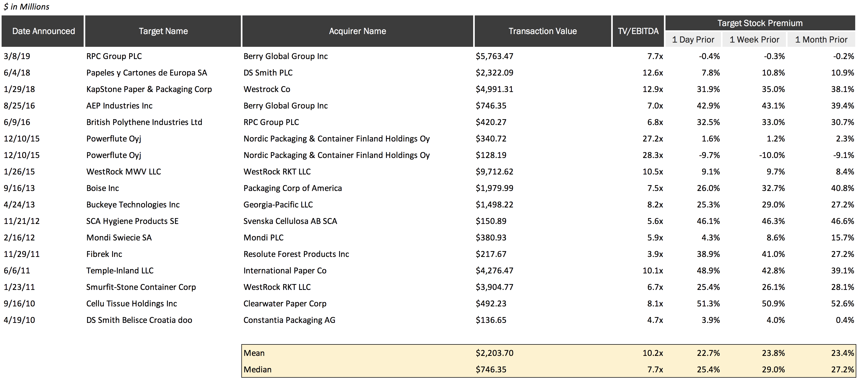
Precedent Paper & Packaging Transactions
Preliminary Views on Valuation
Selected Transactions > 100m, NA/European, Last 10y, Relevant Industries

Slide 27
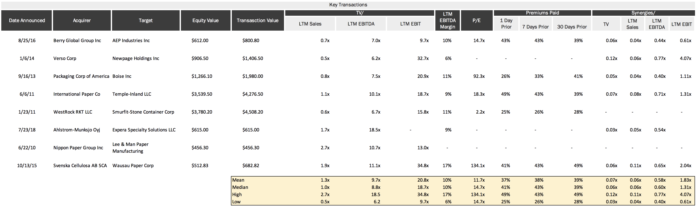
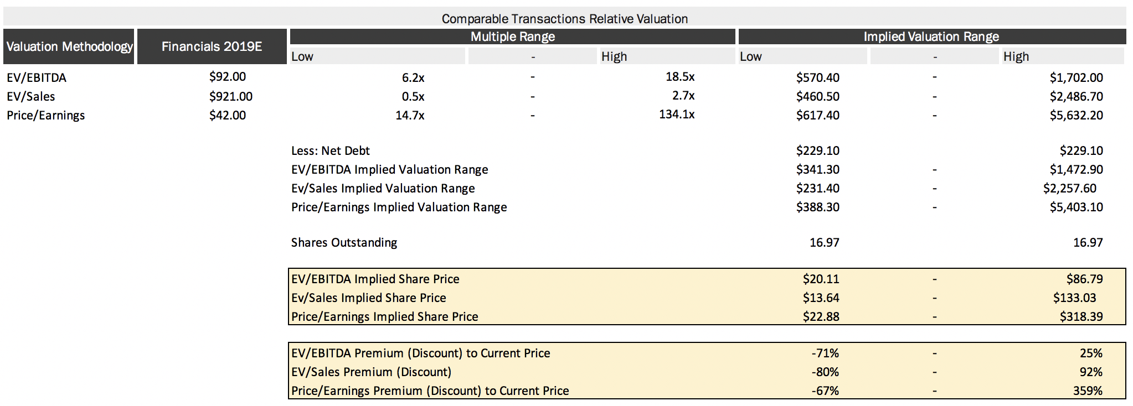
Precedent Transactions Valuation Analysis
Premium Paper and Packaging
Since 2010, premium paper and packaging deals have been executed at multiples from as low as 6.2x to as high as 18.5x LTM EBITDA.
Mean - Median
EV/EBITDA 8.8 – 9.7x
P/E 11.7 – 14.7x

Slide 28
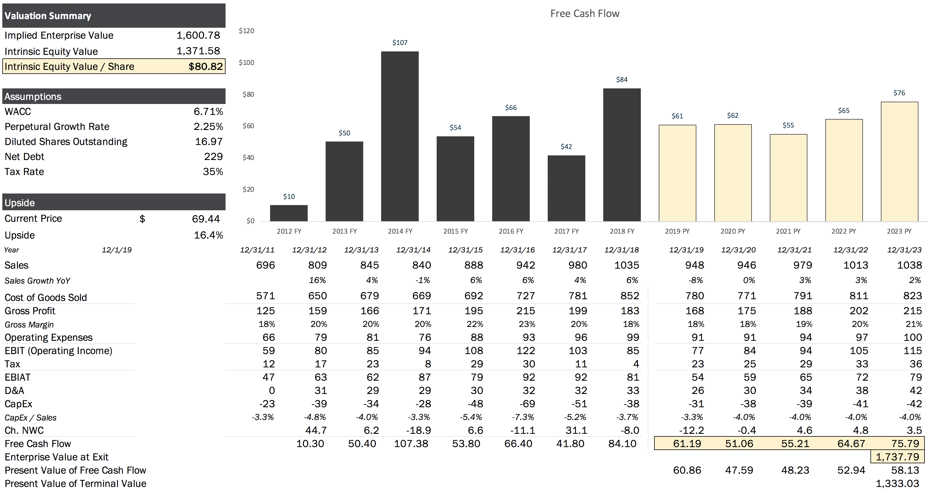
Discounted Cash Flow Analysis
Preliminary Views on Valuation

Slide 29
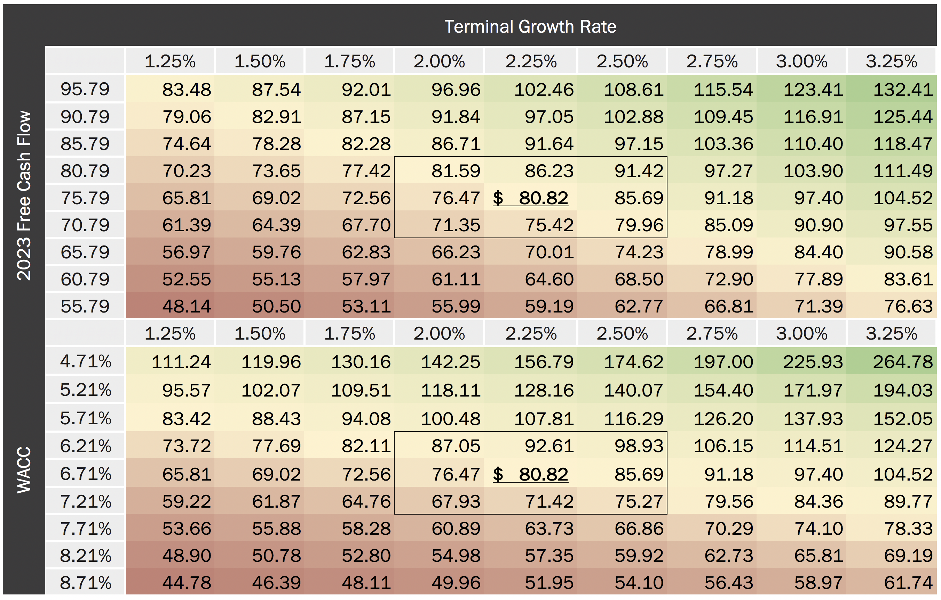
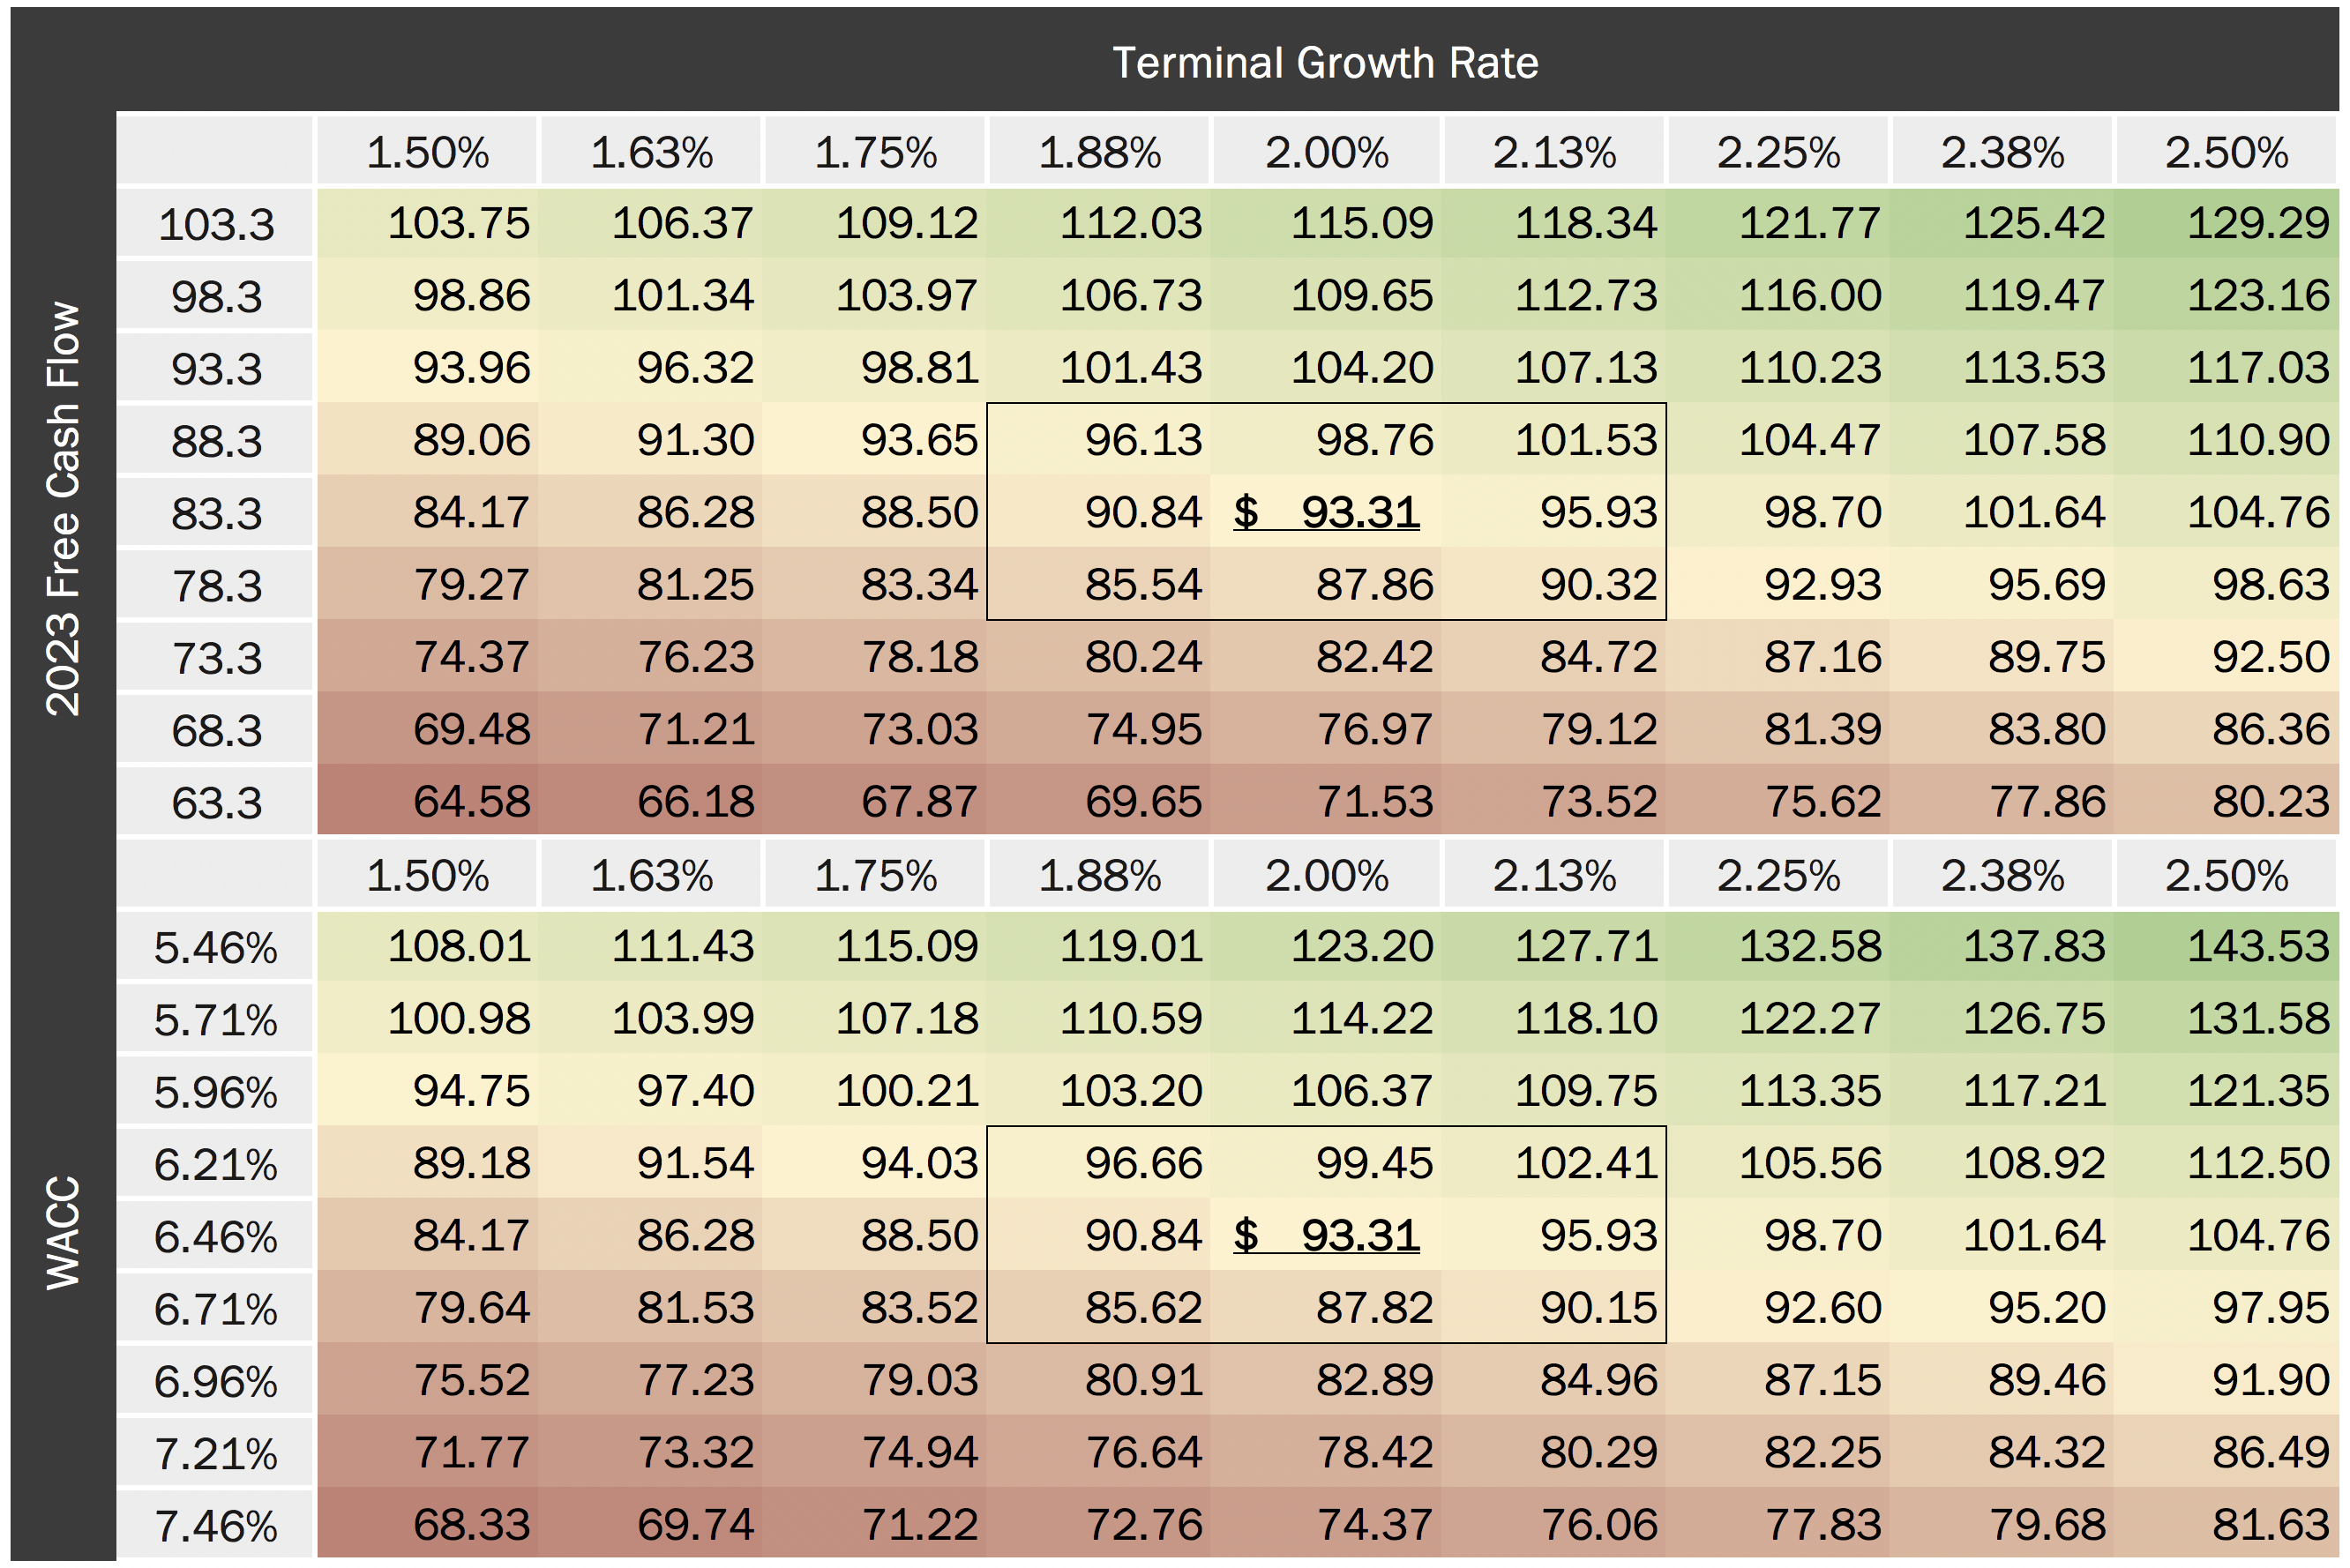
Discounted Cash Flow Analysis (Sensitivity)
Preliminary Views on Valuation

Slide 30
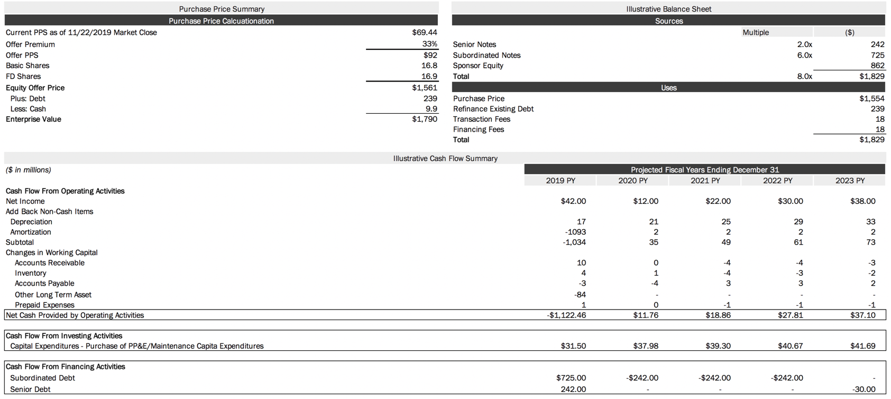
Illustrative Leveraged Buyout Analysis
Preliminary Views on Valuation
Sources & Uses / Cash Flow Summary
Key Assumptions
Transaction date 12/31/2019
Purchase Forward EBITDA Multiple 14.8x
2019E EBITDA $103
Exit EBITDA multiple 15.8x
Minimum PF cash 2.0
35% tax rate
Transaction fee 1%
Financing fees 1%
All existing debt refinanced
Debt Financing
8.0x LTM EBITDA

Slide 31
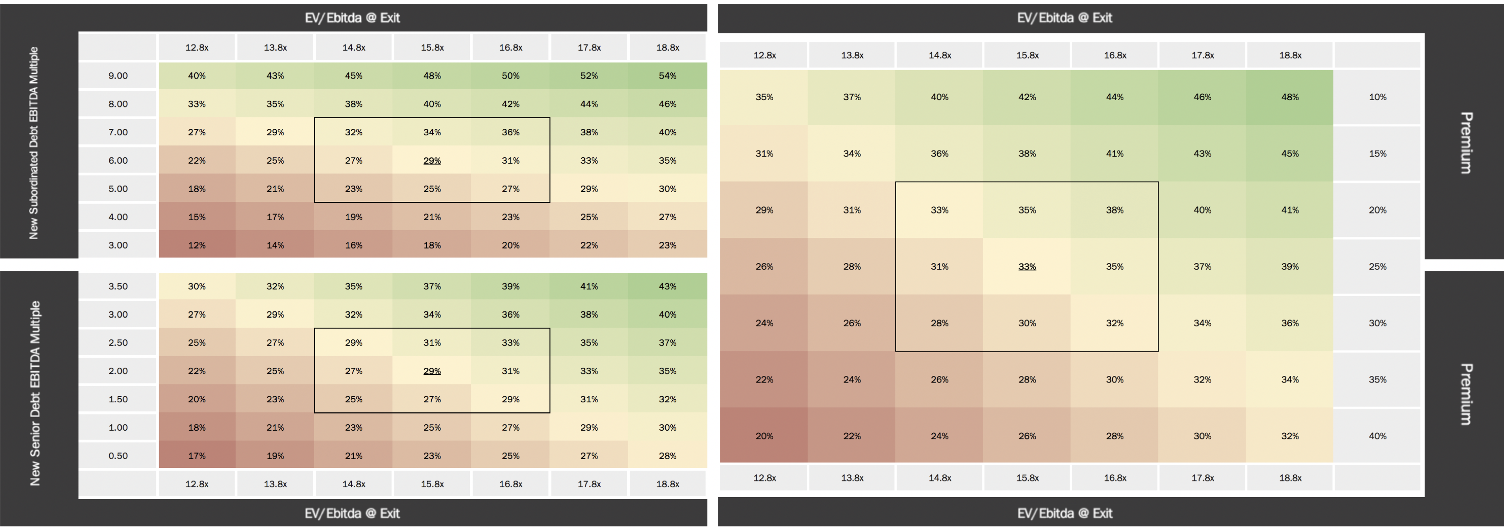
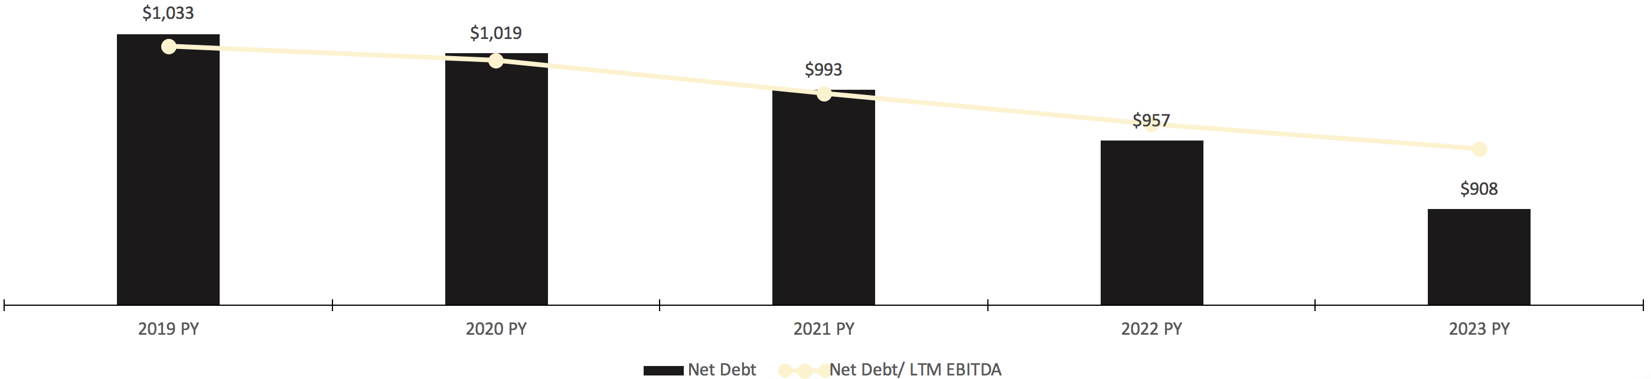
Illustrative Buyout Analysis
Preliminary Views on Valuation
Sensitivity Analysis
Key Assumptions
Transaction date 12/31/2019
Purchase Forward EBITDA Multiple 14.8x
2019E EBITDA $103
Exit EBITDA multiple 15.8x
Minimum PF cash 2.0
35% tax rate
Transaction fee 1%
Financing fees 1%
All existing debt refinanced
Debt Financing
8.0x LTM EBITDA

Slide 32
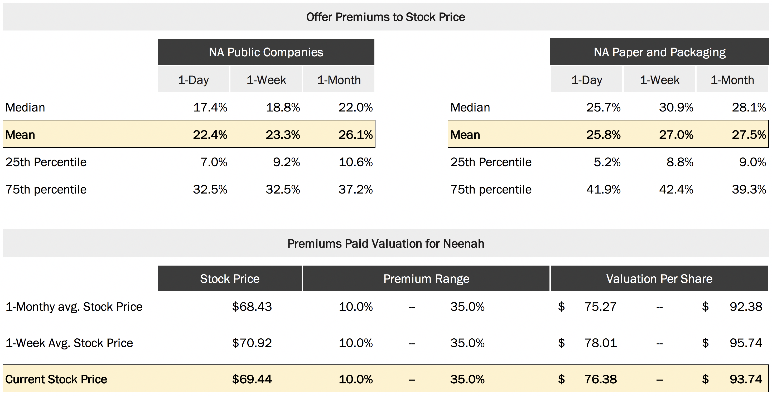
Premiums Paid Analysis
Preliminary Views on Valuation
Market Overview
Premiums paid for paper and packaging companies are slightly higher than the overall market.

Slide 33
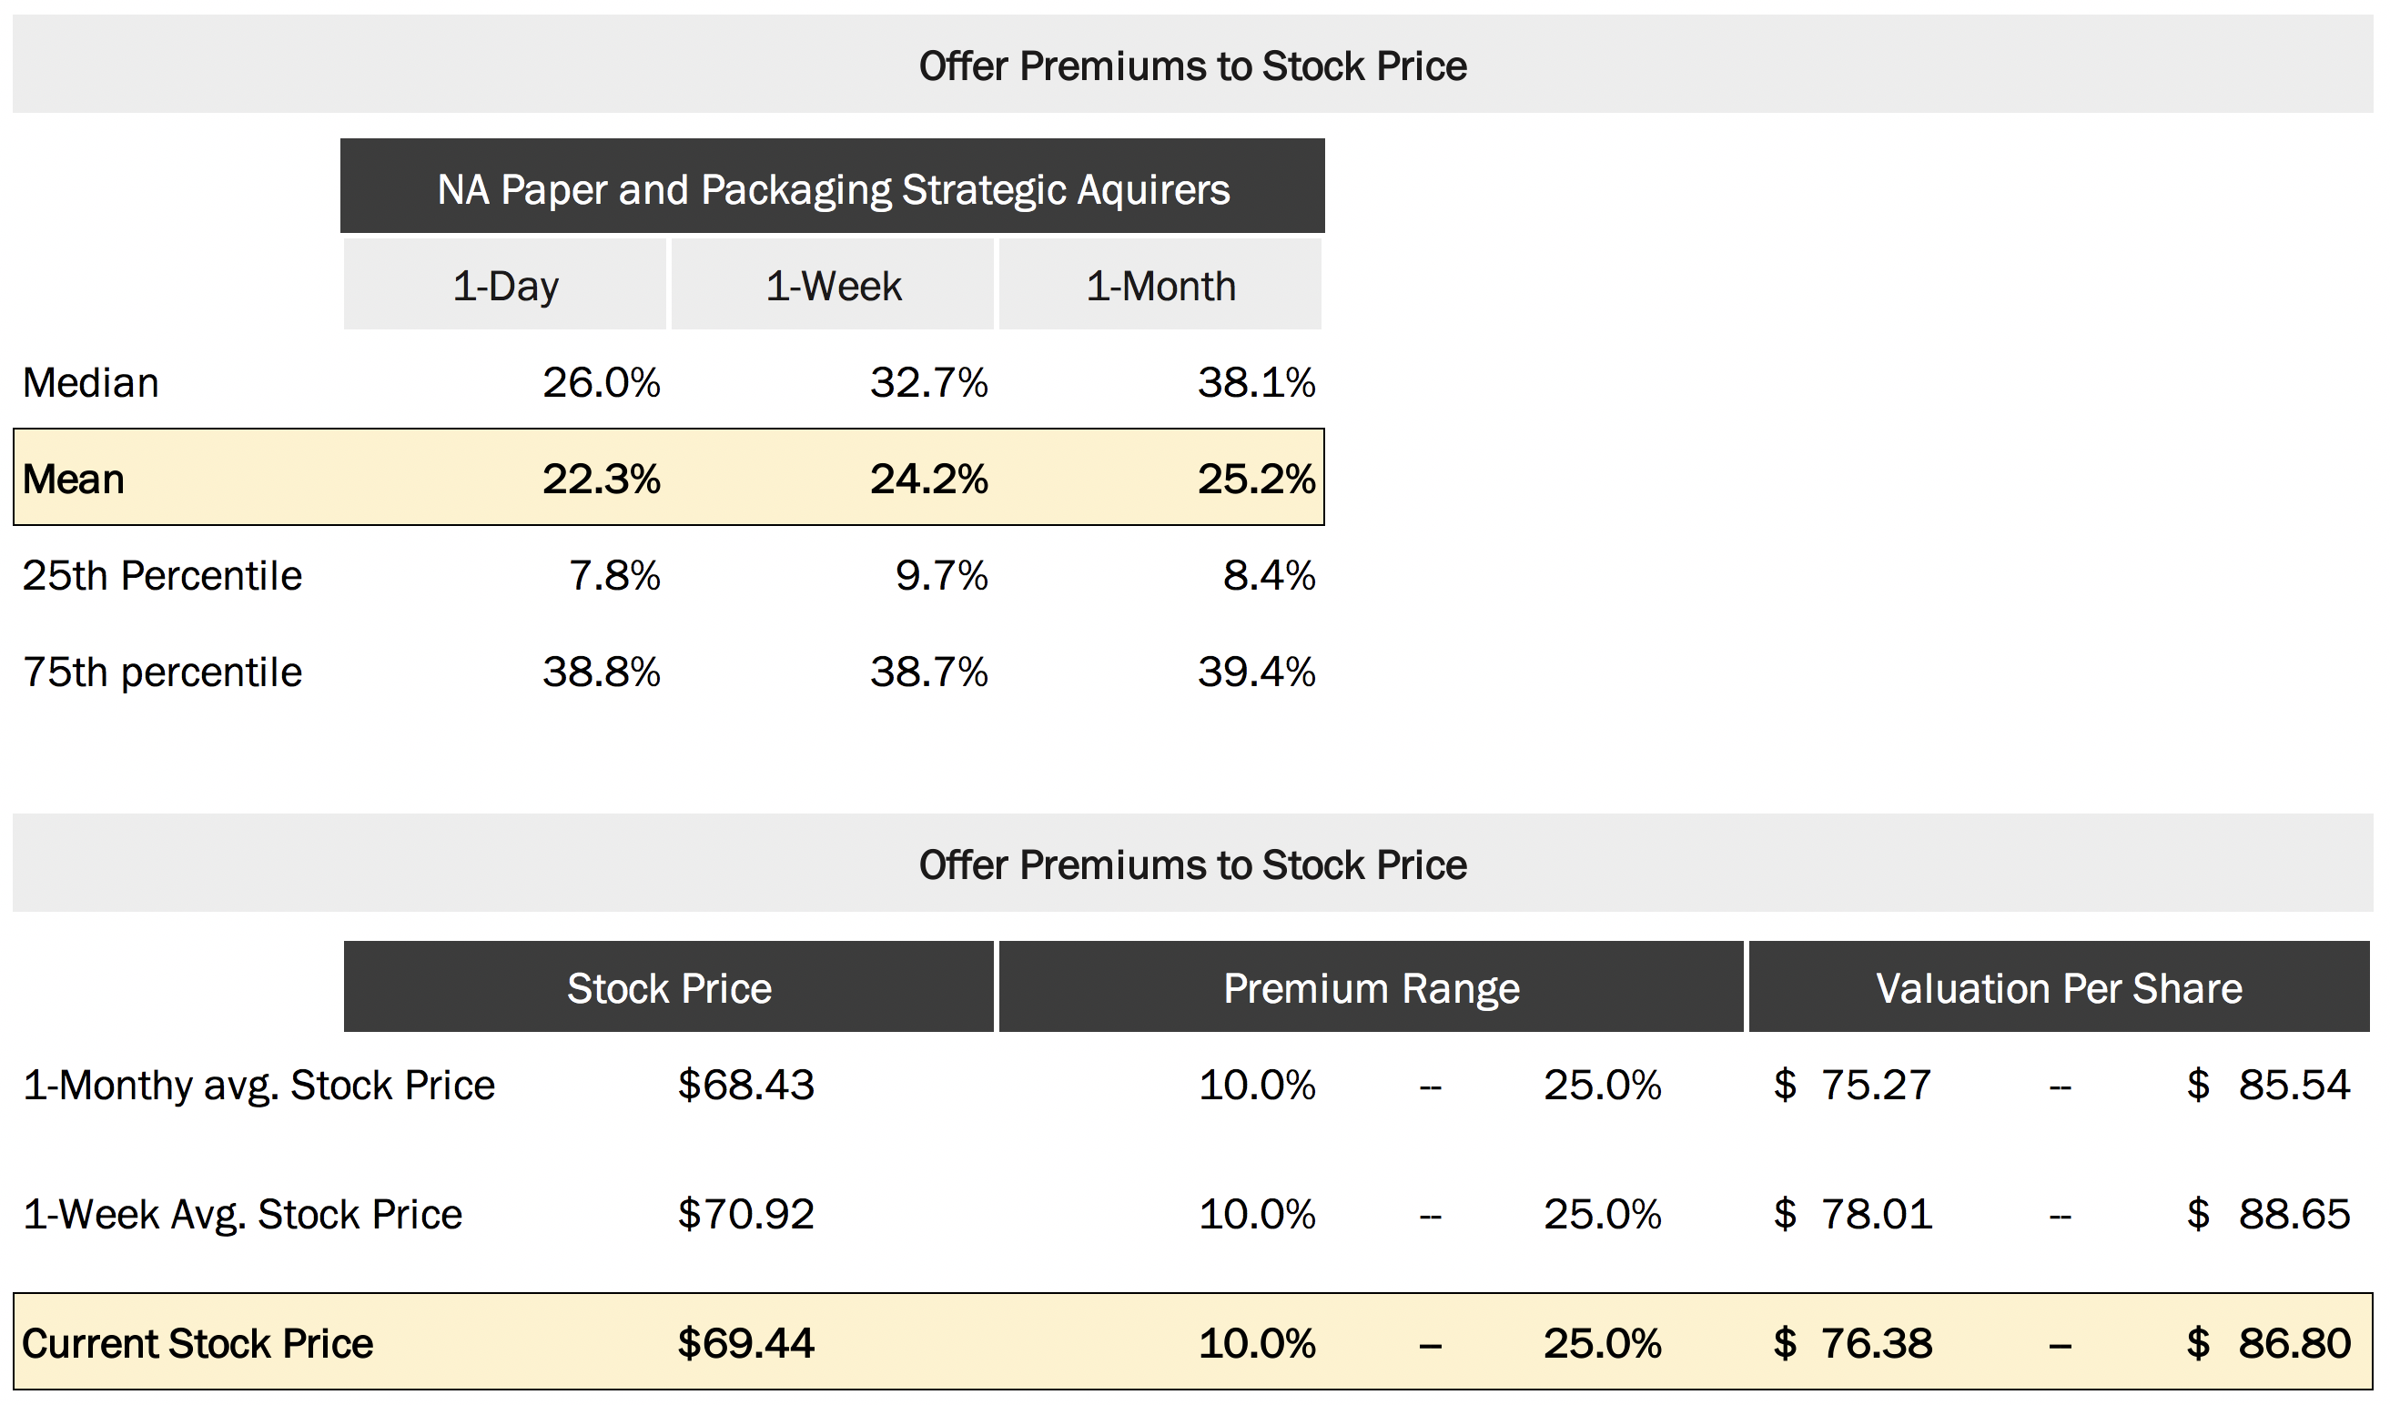
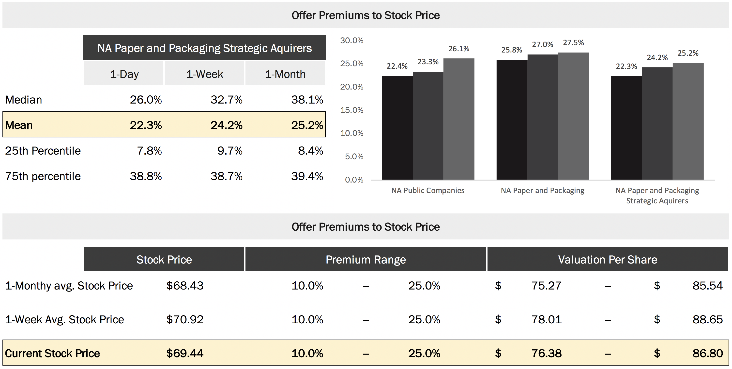
Premiums Paid Analysis (Cont.)
Preliminary Views on Valuation
Strategic Acquirer Focus
Strategic Acquirers attract lower premiums in comparison to the wider market

Slide 34
Table of Contents
Executive Summary
Neenah Business Overview
Public Market Perspectives
Preliminary Views on Valuation
Domtar / Neenah Illustrative Combination
Potential Interloper Analysis
Appendix - Supporting Valuation Materials
Detailed Trading Comps
Neenah WACC Analysis
Proforma Income Statement

Slide 35
Neenah vs Domtar
Side by Side Comparison

Slide 36
Relative Exchange Ratio
Shares of Domtar per Neenah Share

Slide 37
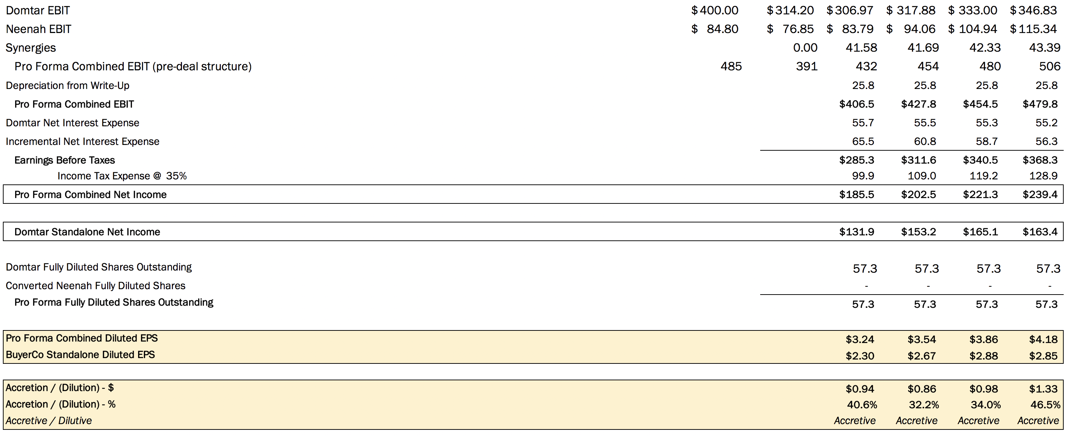
Accretion / (Dilution) Analysis
*Synergies: Effect on EBIT, Revenue Growth +2%, COGS -4%, Op Ex -20%

Slide 38
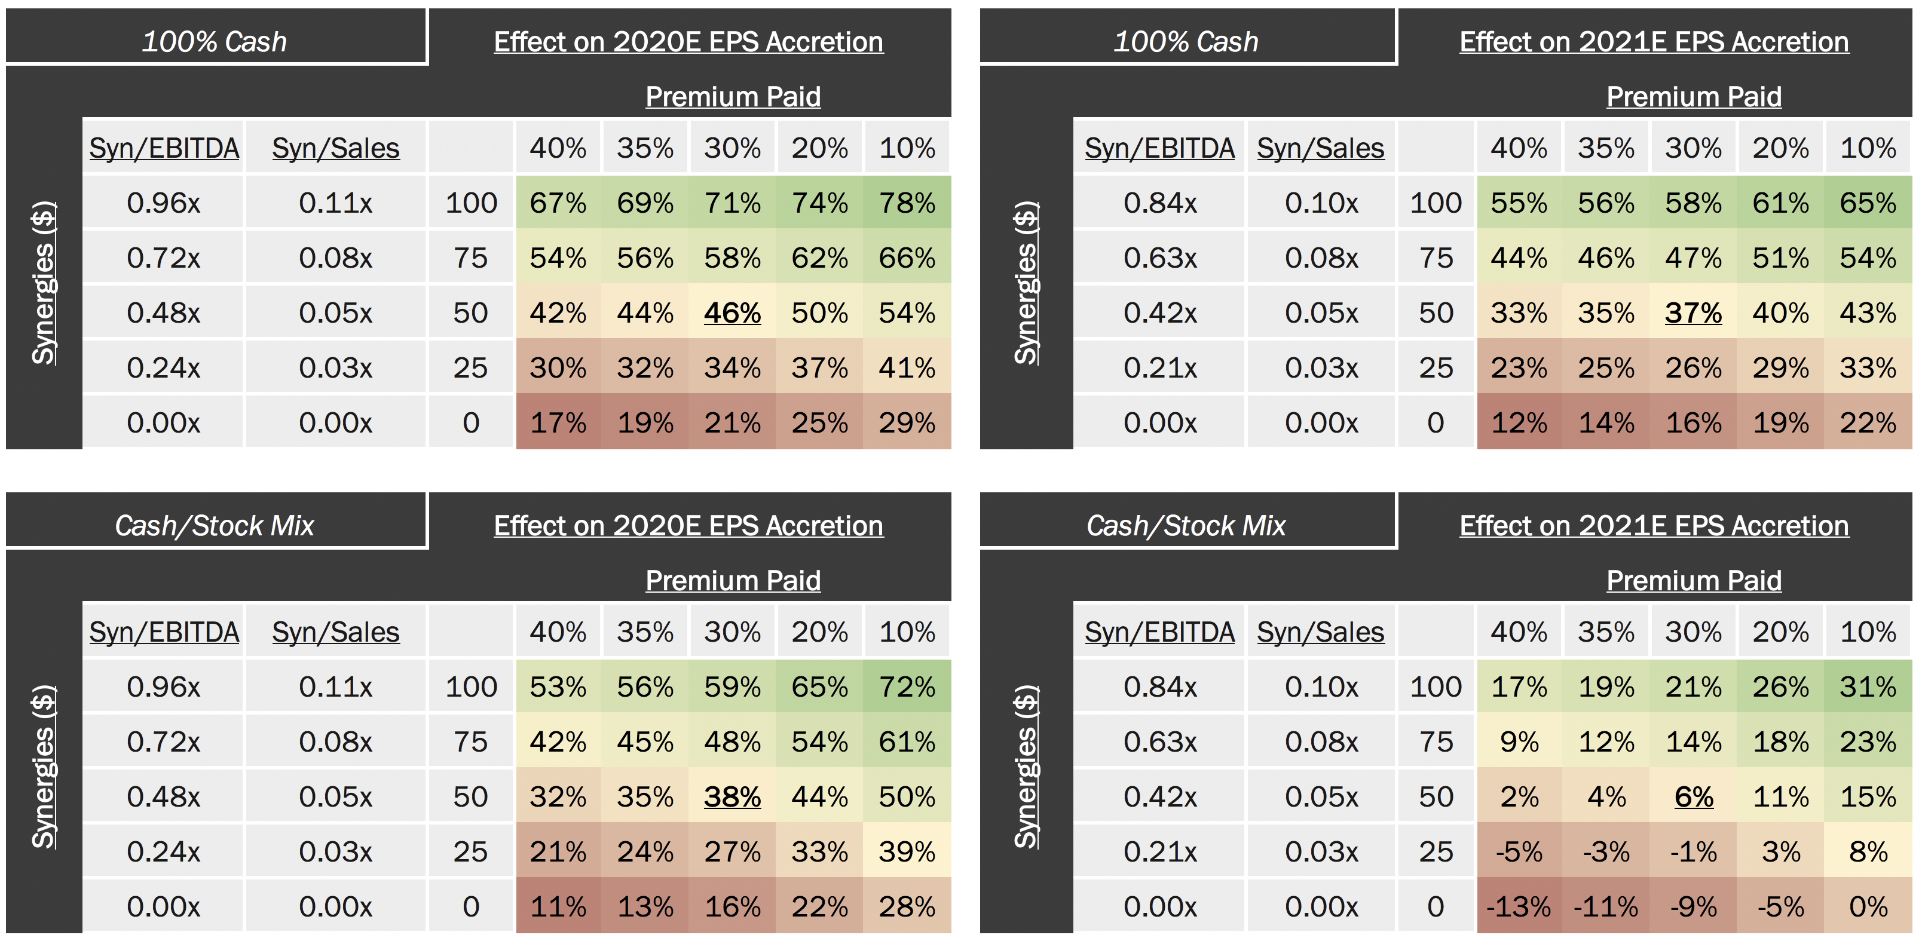
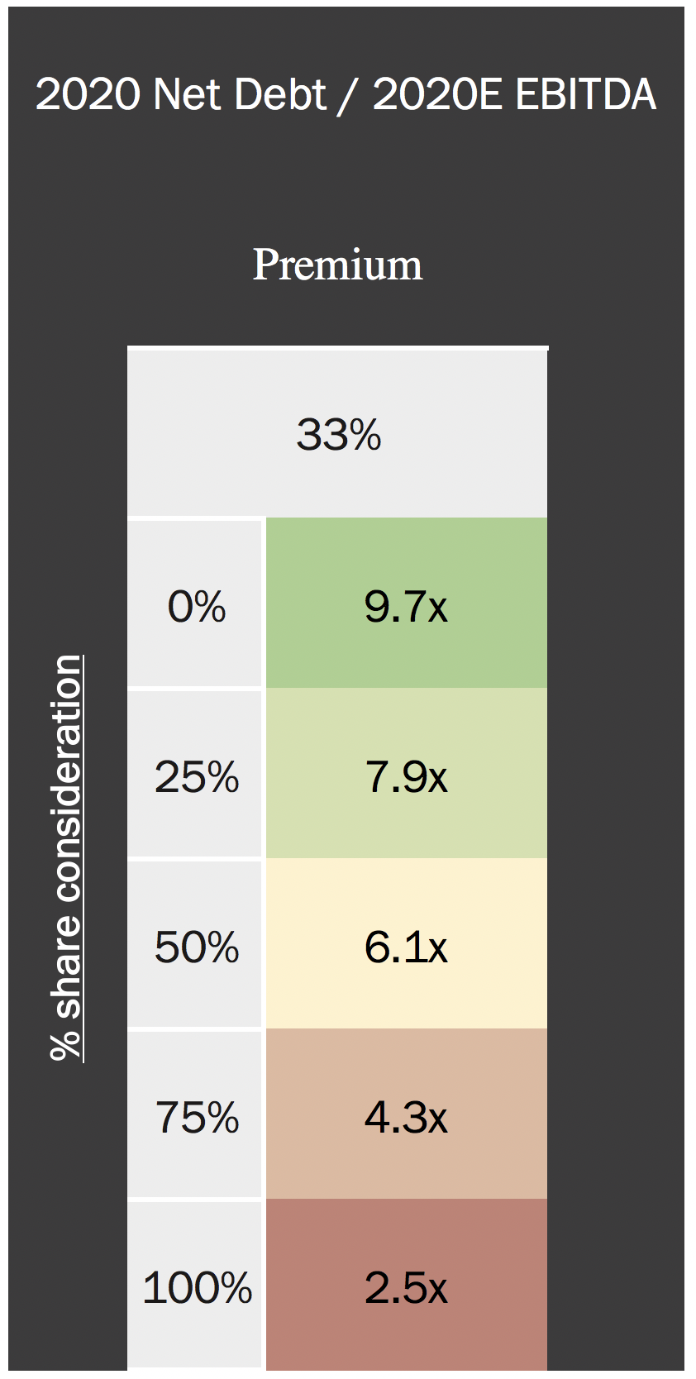
Acquisition of Neenah by Domtar
Financial Analysis of Acquisition

Slide 39
Table of Contents
Executive Summary
Neenah Business Overview
Public Market Perspectives
Preliminary Views on Valuation
Domtar / Neenah Illustrative Combination
Potential Interloper Analysis
Appendix - Supporting Valuation Materials
Detailed Trading Comps
Neenah WACC Analysis
Proforma Income Statement

Slide 40
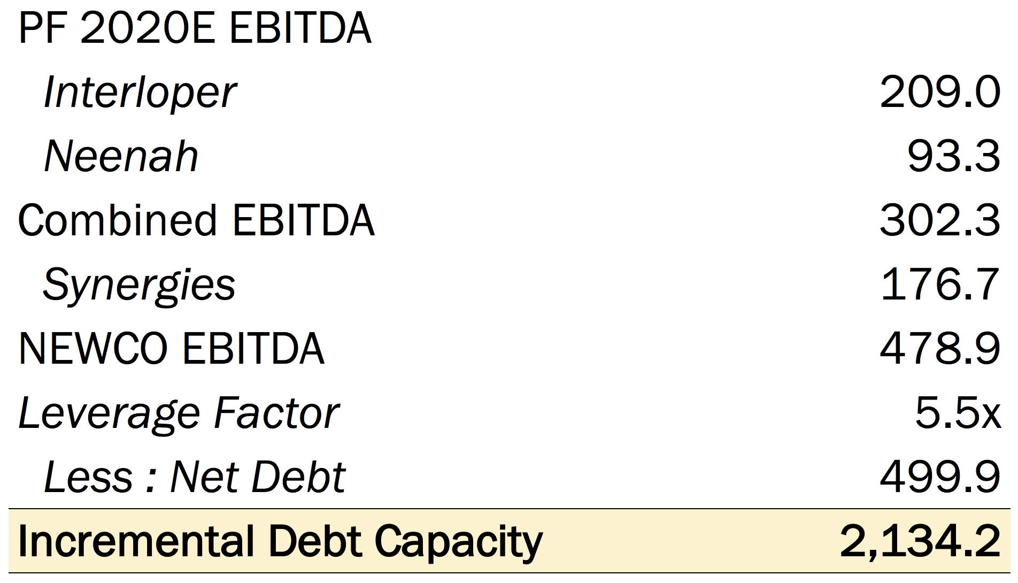


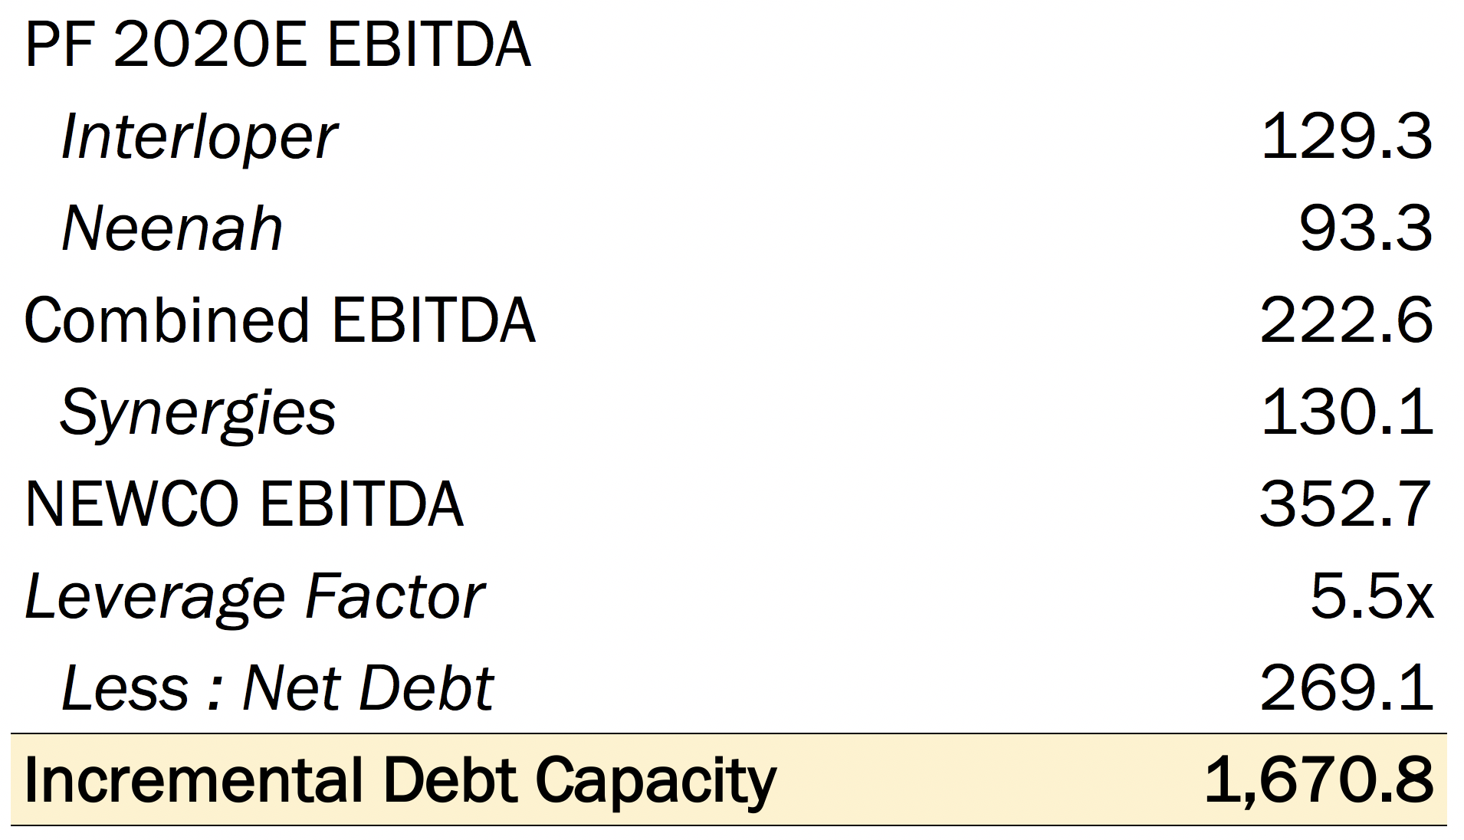


Overview of Potential Interlopers
Illustrative Interloper Analysis
Business Description
Size (mm)
Financial Capacity (mm)
Comments
Schweitzer-Mauduit International, Inc. manufactures and sells fine papers to the tobacco industry. The Company also produces specialty paper products for use in other applications such as alkaline batteries, vacuum cleaner bags, business forms, and printing and packaging applications.
Schweitzer-Mauduit
Market Cap - $1,333.0
Schweitzer-Mauduit is entrenched in fine paper and could efficiently integrate Neenah’s business
P.H. Glatfelter Co, commonly known as Glatfelter, manufactures specialty paper and engineered products. The Company's products include custom applications such as playing cards and digital imaging papers, as well as printing, converting papers, and long-fiberand overlay papers.
P.H. Glatfelter
Market Cap - $777.4
Glatfelter has limited exposure to fine paper
This transaction would allow them to diversify their portfolio of products and expand into a premium market.
Cascades Inc. produces paper and packaging products. The Company manufactures, converts, and markets specialty products, including boxboard, fine papers, tissue paper, and containerboard. Cascades and its subsidiaries operate in Canada, the United States, France, Sweden, Germany, and Great Britain.
Cascades
Market Cap - $1,195.5
Already has segments in fine paper
Increasing penetration in American market would make the transaction attractive

Slide 41

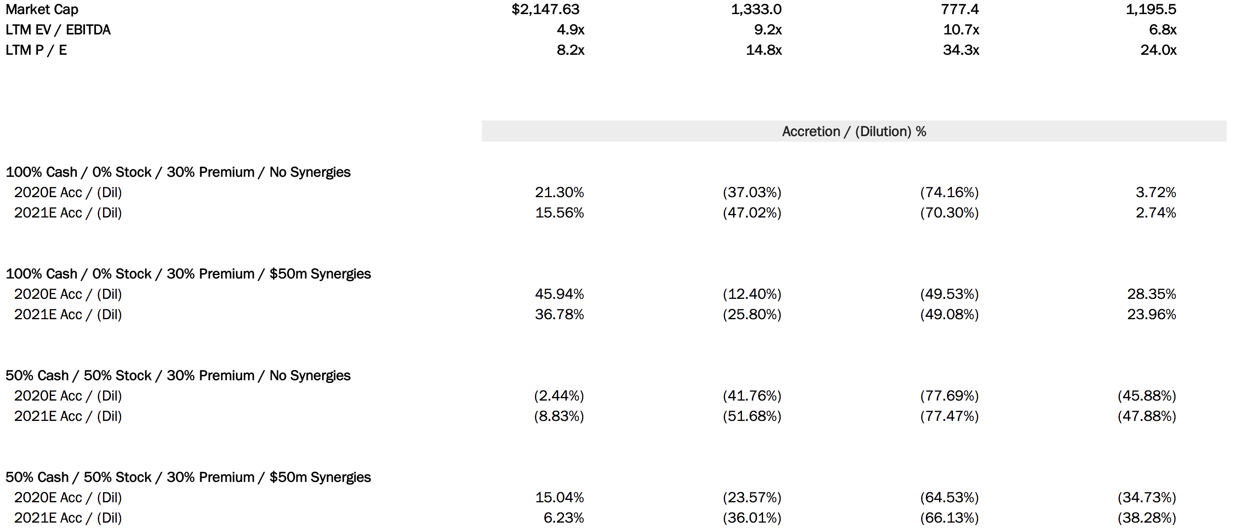
Alternative Acquirer Analysis
Illustrative Interloper Analysis
From this analysis Cascades appears to be the most likely potential interloper on this deal, and they would likely finance it with 100% cash. However, Schweitzer-Mauduit or Glatfelter might also be interested if they could realize larger synergies from the transaction.
It is clear Domtar has the most to gain from going through with this transaction.
($ in Millions)

Slide 42
Table of Contents
Executive Summary
Neenah Business Overview
Public Market Perspectives
Preliminary Views on Valuation
Domtar / Neenah Illustrative Combination
Potential Interloper Analysis
Appendix - Supporting Valuation Materials
Detailed Trading Comps
Neenah WACC Analysis
Proforma Income Statement

Slide 43
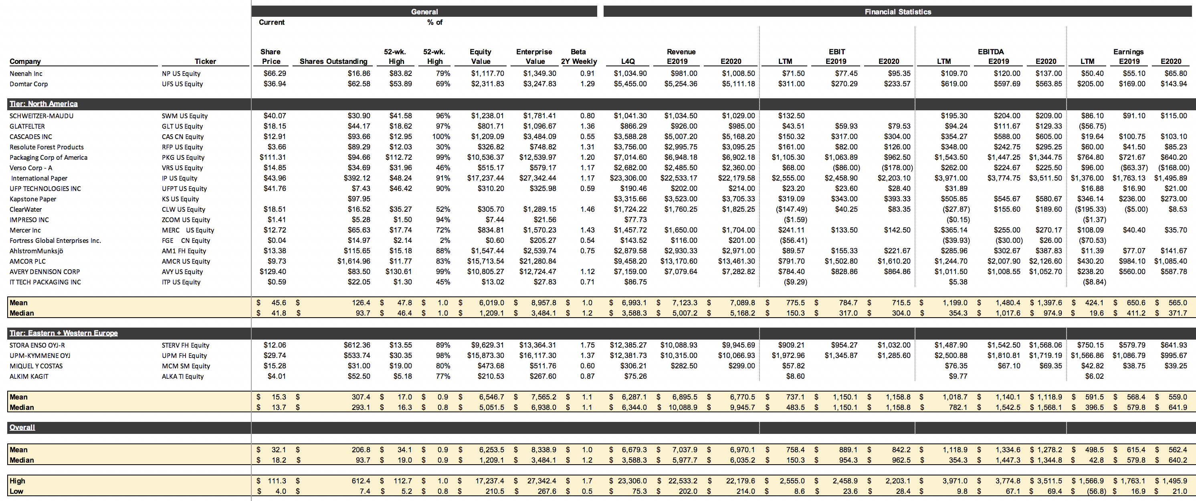
Comparable Companies Analysis
Detailed Trading Comps
Trading Statistics

Slide 44
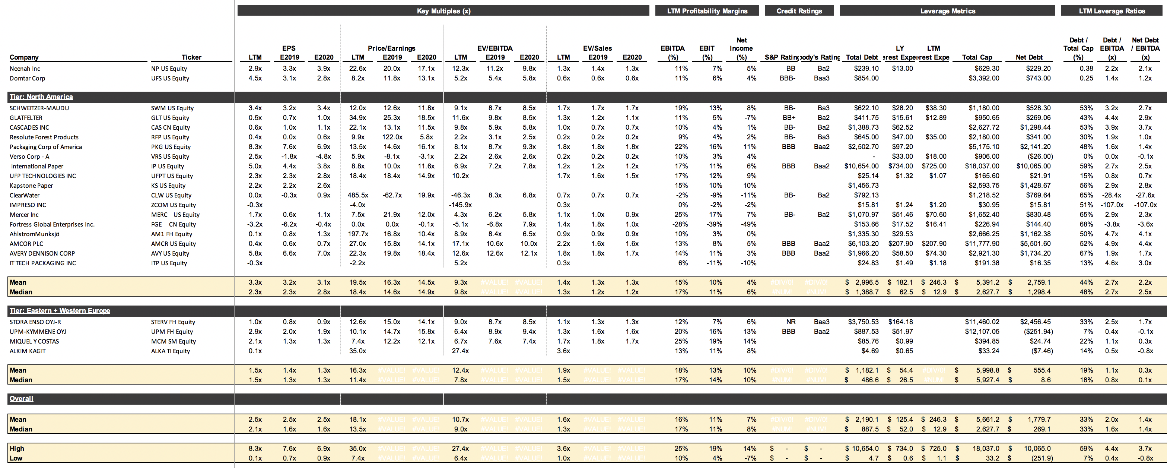
Comparable Companies Analysis
Detailed Trading Comps
Trading Statistics

Slide 45
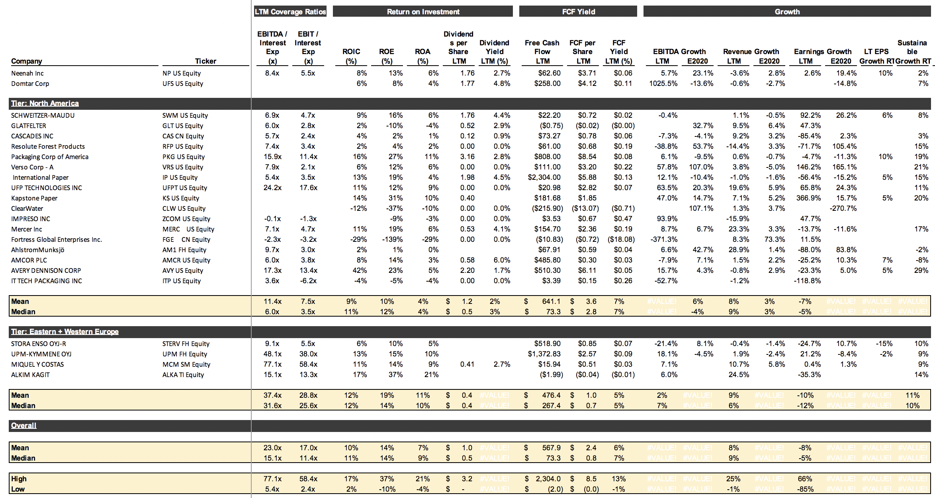
Comparable Companies Analysis
Detailed Trading Comps
Trading Statistics

Slide 46
Table of Contents
Executive Summary
Neenah Business Overview
Public Market Perspectives
Preliminary Views on Valuation
Domtar / Neenah Illustrative Combination
Potential Interloper Analysis
Appendix - Supporting Valuation Materials
Detailed Trading Comps
Neenah WACC Analysis
Proforma Income Statement

Slide 47
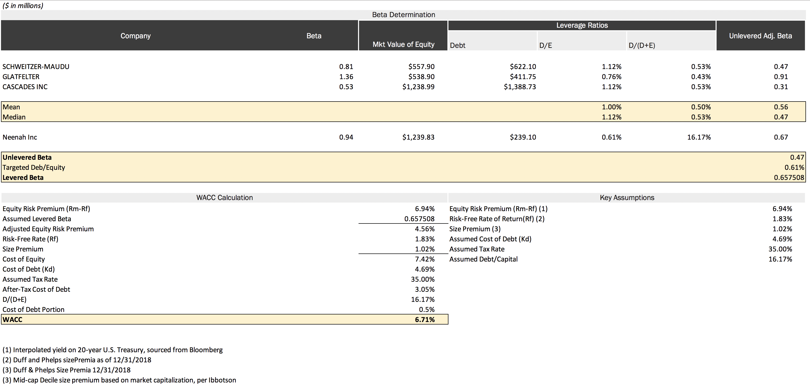
WACC Analysis
Neenah WACC Analysis

Slide 48
Table of Contents
Executive Summary
Neenah Business Overview
Public Market Perspectives
Preliminary Views on Valuation
Domtar / Neenah Illustrative Combination
Potential Interloper Analysis
Appendix - Supporting Valuation Materials
Detailed Trading Comps
Neenah WACC Analysis
Proforma Income Statement

Slide 49
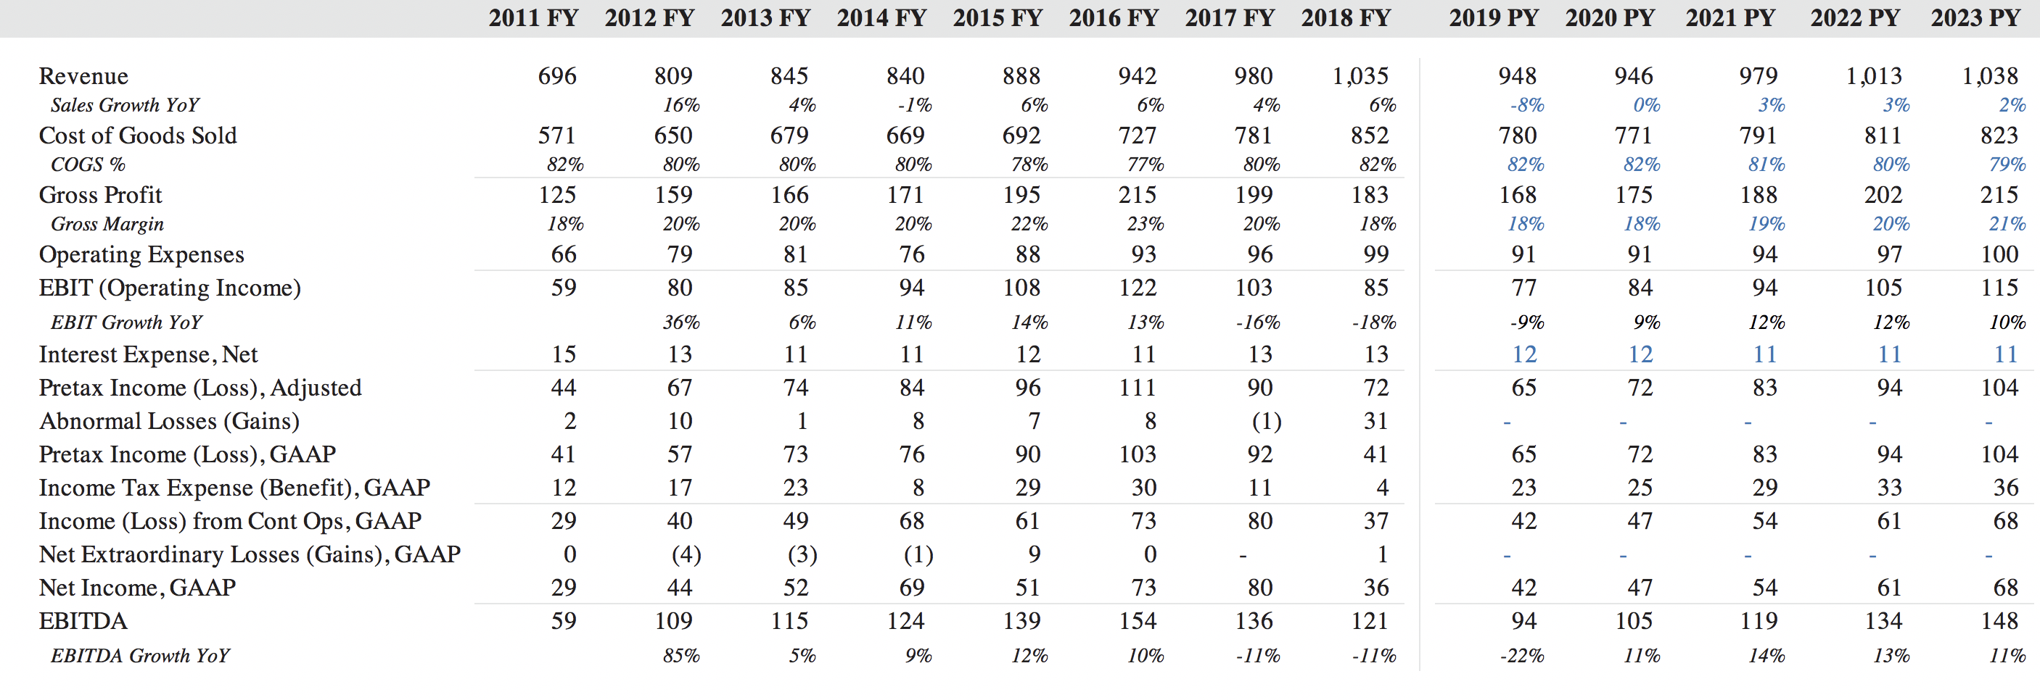
Proforma Income Statement
Financial Projections

